Slide 1
Happiness and gene expression… CTRA genes modulate the stress/threat response: pro-inflammatory, increased risk of arterial disease, cancer, neuro-degeneration and suppression of viral immunity
But there are TWO kinds of happiness:
Eudaimonic happiness - from the joy of serving others, compassion, caring.
Hedonic happiness - from serving your own material desires and pleasure
Hedonic happiness up-regulates CTRA genes – risk of chronic disease!
Eudaimonic happiness down-regulates CTRA genes – stay healthy!
Notes:
Fredrickson BL, Grewen KM, Coffey KA, Algoe SB, Firestine AM, Arevalo JM, et al. A functional genomic perspective on human well-being. Proc Natl Acad Sci U S A. 2013;110(33):13684-9.
CTRA is a cluster of 53 genes modulating the acute stress/threat response. Chronic activation is pro-inflammatory, a major risk factor for arterial and cardiac disease, cancer, and neuro-degerative disorders. Activation also suppresses the immune response to viral infection.

Slide 2
Dean Ornish, MD
Comprehensive lifestyle change can reverse coronary artery disease and halt the progression of prostate cancer (controlled trials)
How does Dr Ornish define lifestyle change?
Good diet Moderate exercise Social support Relaxation
Notes:
Ornish D, Scherwitz LW, Billings JH, Brown SE, Gould KL, Merritt TA, et al. Intensive lifestyle changes for reversal of coronary heart disease. Jama. 1998;280(23):2001-7.
Ornish D, Magbanua MJ, Weidner G, Weinberg V, Kemp C, Green C, et al. Changes in prostate gene expression in men undergoing an intensive nutrition and lifestyle intervention. Proceedings of the National Academy of Sciences of the United States of America. 2008;105(24):8369-74.
Ornish D, Weidner G, Fair WR, Marlin R, Pettengill EB, Raisin CJ, et al. Intensive lifestyle changes may affect the progression of prostate cancer. J Urol. 2005;174(3):1065-9; discussion 9-70.
Dean Ornish is the founder of the Preventive Medicine Research Institute and the world authority of impact of lifestyle change on disease progression.

Slide 3
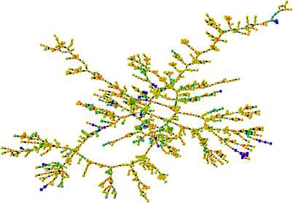
Depression is a contagious disease.
The full network analysis shows that subjects are 93% more likely to be depressed if a person they are directly connected to is depressed.
The size of the effect for people at two degrees of separation (the friend of a friend) is 43% and for people at three degrees of separation (the friend of a friend of a friend) is 37%.
Depression clusters in the Framingham social network (n=957)
Molecular Psychiatry (2011) 16, 273–281; doi:10.1038/mp.2010.13; published online 16 March 2010
Notes:
Rosenquist JN, Fowler JH, Christakis NA. Social network determinants of depression. Mol Psychiatry. 2011;16(3):273-81.
Social network analysis examines how phenomena spread in social networks over time by identifying degrees of separation. One degree of separation is a direct social connection, such as a friend or family member. Two degrees of separation refers to a ‘friend of a friend’.
This social network analysis shows that treating illness as an individual phenomenon is unhelpful and misleading because some common medical problems like depression and obesity and lifestyle factors like smoking occur in clusters of people and are strongly socially influenced. It would make more sense to treat clusters of patients together.
This individualistic viewpoint is a strong characteristic of Western culture. Many indigenous cultures, such as Maori people in New Zealand, simply don’t have a concept of health being an individual phenomenon – it occurs in the context of relationships.

Slide 4
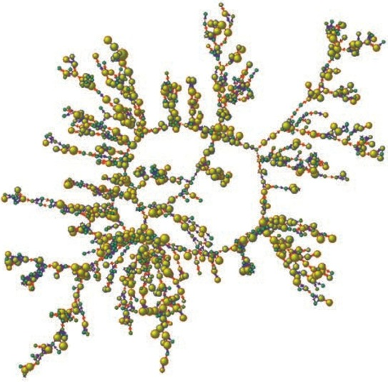
Smoking is a contagious disease.
The full network analysis shows that subjects are 61% more likely to be a smoker if a person they are directly connected to is a smoker.
The size of the effect for people at two degrees of separation (the friend of a friend) is 29% and for people at three degrees of separation (the friend of a friend of a friend) is 11%.
Smoking clusters in the Framingham social network – yellow circle is smoker (n=1000)
N Engl J Med 2008;358:2249-58.
Notes:
Christakis NA, Fowler JH. The collective dynamics of smoking in a large social network. N Engl J Med. 2008;358(21):2249-58.
See preceding slide for explanation of social networks

Slide 5
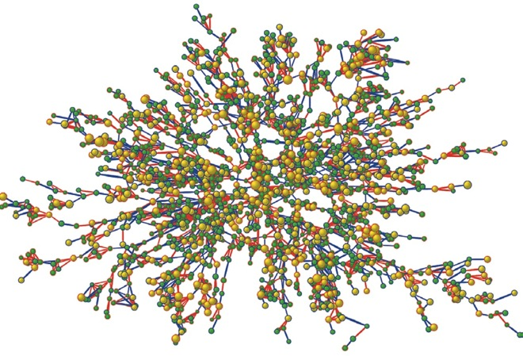
Obesity is a contagious disease.
The full network analysis shows that subjects are 45% more likely to be obese if a person they are directly connected to is obese.
The size of the effect for people at two degrees of separation (the friend of a friend) is 20% and for people at three degrees of separation (the friend of a friend of a friend) is 10%.
Obesity clusters in the Framingham social network – yellow circle is obese (n=2200)
N Engl J Med 2007;357:370-9.
Notes:
Christakis NA, Fowler JH. The spread of obesity in a large social network over 32 years. N Engl J Med. 2007;357(4):370-9.
See notes in previous slides

Slide 6
Strong African American Families (SAAF) Project
Randomised, controlled trial, 700 families with 11-year-old children
Taught the skill for nurturant, involved parenting
Eight years later, when children 19, blood tests measured six different inflammation markers. Those in SAAF group had significantly lower levels of every one, compared with controls.
Proceedings of the National Academy of Sciences of the United States of America, 111, 11287-11292.
Notes:
Miller GE, Brody GH, Yu T, Chen E. A family-oriented psychosocial intervention reduces inflammation in low-SES African American youth. Proc Natl Acad Sci U S A. 2014;111(31):11287-92.
This randomized, controlled trial of 272 mothers and their 11-year old children involved a 7-week psychosocial intervention to teach nurturant patenting skills to poor African American families in Georgia, or assignment to a control group. Analysis eight years later, when the children were 19 years old, showed that those in the intervention group had on average half the alcohol consumption of those in the control group, and all six tests of inflammatory cytokines showed lower levels of inflammation.

Slide 7
fMRI
Improved performance on cognitive tests
Increased activity in pre-frontal cortex
Increased volume of hippocampus
Credit: AARP Facebook
AARP Experience Corp volunteers – randomised controlled trial
Alzheimers Dement. 2015 Nov;11(11):1340-8. doi: 10.1016/j.jalz.2014.12.005. Epub 2015 Mar 31.
Notes:
Carlson MC, Kuo JH, Chuang YF, Varma VR, Harris G, Albert MS, et al. Impact of the Baltimore Experience Corps Trial on cortical and hippocampal volumes. Alzheimers Dement. 2015;11(11):1340-8.
This two-year long randomized, controlled trial asked elderly participants to spend 15 hours a week teaching literacy and reading skills to children in low-income schools. Those in the control group showed progressive loss of volume in the cerebral cortex and hippocampus (important for memory function) while those in the intervention group showed improved performance in cognition and memory tests and increased volume in these areas of the brain.

Slide 8
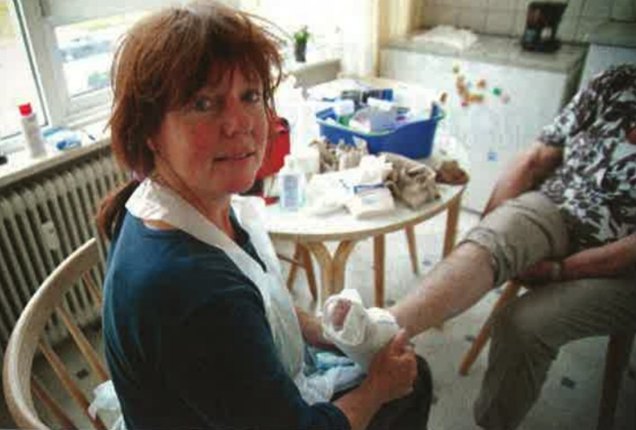
Home nursing care in the Netherlands
7,000 nurses
‘Best employer’ in the Netherlands 3 years running
Average patient satisfaction 9.1/10
ED visits reduced by 1/3
Patients recovered twice as fast
Productivity improved by 40% Ernst & Young 2009
Notes:
http://www.commonwealthfund.org/publications/case-studies/2015/may/home-care-nursing-teams-netherlands
Buurtzorg is a large organisation delivering home nursing care in the Netherlands, now employing over 8,000 nurses. It began with four nurses in 2007 and rapidly expanded to almost entirely replace the legacy system.
The old system had a highly regulated system of monitoring tasks and efficiency but many nurses were dissatisfied with task-driven care. Buurtzorg introduced completely autonomous teams of ten to twelve nurses to serve each locality and there are literally no managers or bosses – except for a small national office to handle contracts and finances. Nurses are free to organize their own work and to choose their priorities for whole patient, compassionate care. They are linked by a secure social network (similar to Facebook) where they can share problems, stories and solutions.
The consulting company, Ernst & Young published a report in 2009, comparing the performance of the old and the new system. They found a dramatic improvement in productivity, in patient satisfaction – the highest score of any health service in the country, in patient outcomes, and employee satisfaction.
The extraordinary success of Buurtzorg is encouraging for two reasons: Firstly, it shows that when health professionals are given autonomy to provide compassionate, whole person care, outcomes and costs are transformed compared with a manager-driven system of tasks and efficiency ratings. Secondly, it provides a model for rapid reorganization of healthcare services where a new service suddenly emerges and expands rapidly to take over the legacy system. Nobody planned this reform, it happened spontaneously as large numbers of nurses chose to leave the old system and join Buurtzorg.
If we want to create a more compassionate healthcare system – better for both patients and professionals – we should focus on creating entirely new systems of care and not trying to persuade the old system to change.

Slide 9
United Nations (UN): Chronic disease and cancer can be reduced 80% by adopting a healthy lifestyle. Happy people make healthy choices
Notes:
United Nations report on impact of lifestyle on disease: https://unchronicle.un.org/article/lifestyle-diseases-economic-burden-health-services
“The combination of four healthy lifestyle factors -- maintaining a healthy weight, exercising regularly, following a healthy diet, and not smoking -- seem to be associated with as much as an 80 per cent reduction in the risk of developing the most common and deadly chronic diseases”

Slide 10
80-90% of all chronic disease and cancer is caused by the patients’ emotional and physical habits – their lifestyle.
Notes:
United Nations report on impact of lifestyle on disease: https://unchronicle.un.org/article/lifestyle-diseases-economic-burden-health-services
“The combination of four healthy lifestyle factors -- maintaining a healthy weight, exercising regularly, following a healthy diet, and not smoking -- seem to be associated with as much as an 80 per cent reduction in the risk of developing the most common and deadly chronic diseases”

