Slide 1
Caring takes no time – it’s an attitude!
Notes:
Health professionals all around the world say, “We just don’t have time to care”. Extreme time pressure in the workplace is one of the factors for burnout. But in fact, caring has no dimensions of time – it’s an attitude and kindness and caring and wanting to address suffering. You can be extremely busy with all your tasks and do it in a grumpy, detached or uncaring way – as can occur in burnout – or you can do the exact same series of tasks with an attitude and kindness and caring – it takes the exact same amount of time.
Think of a personal story you could tell about nurses or doctors who displays different attitudes
When care is only focused on a series of tasks, time is mechanical, like the ticking second hand on a clock. When we make the human connection with compassionate care, time slows down and expands.

Slide 2
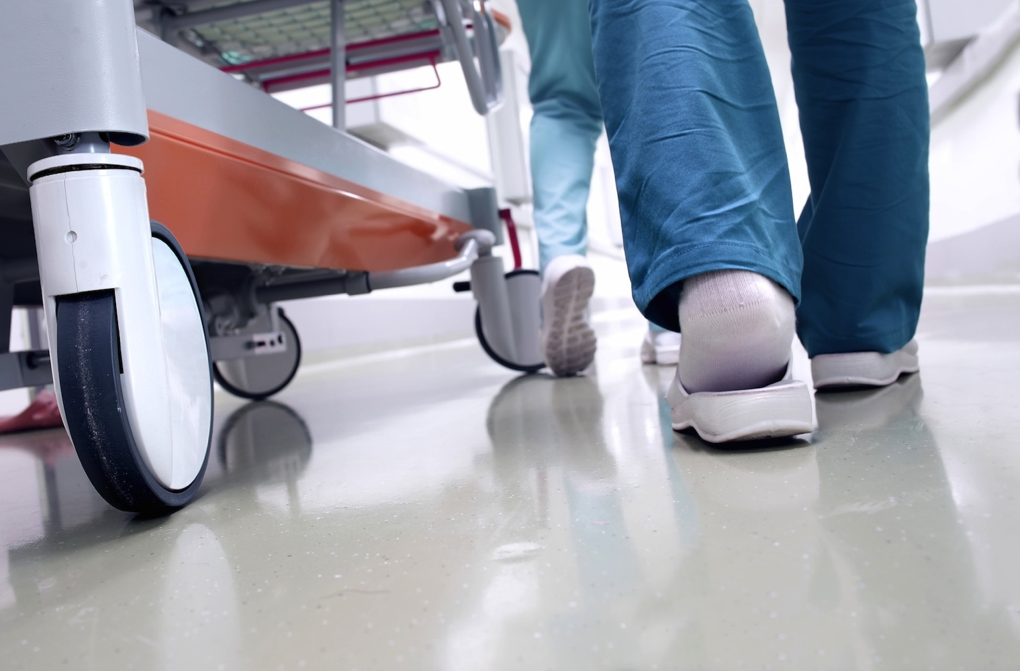
Caring is shown in the smallest acts that take just a moment…
Notes:
I suggest you find your own story and image to go with this slide.
I use this image to tell the story of he day my 18-year old daughter was admitted to hospital after a serious car accident – she had a broken neck and back and other injuries (from which she fully recovered!).
I tell the story of how frightened and vulnerable we felt as parents and how, in that state you are incredibly sensitive and grateful for small acts of kindness and caring. On her first day in hospital, our daughter made many journeys along the corridors, cared for by an en extraordinarily compassionate and sensitive transit care nurse. On one journey, we passed along the corridor from one building to the next and there was a join in the floor, a metal strip. Mindful of our daughter’s broken bones, the nurse stopped the trolley and carefully lifted each wheel over the bump in the floor. I cannot tell that story without getting tears in my eyes. It took maybe 30 seconds. We will remember that act of kindness for the rest of our lives.
I suggest you don’t use my story but you find your own story about a brief moment of compassionate care, then seach for an image to represent the story.

Slide 3
Dramatic reduction in healthcare utilisation as a result of finding common ground with patient, through compassionate, patient-centred primary care (Stewart 2000)
25%
15%
4%
6%
Patients who found common ground with their doctor also had better recovery from their discomfort and concern, and better mental health 2 months later
Notes:
1. Stewart M, Brown JB, Donner A, McWhinney IR, Oates J, Weston WW, et al. The impact of patient-centered care on outcomes. J Fam Pract. 2000;49(9):796-804.
METHODS: We selected 39 family physicians at random, and 315 of their patients participated. Office visits were audiotaped and scored for patient-centered communication. In addition, patients were asked for their perceptions of the patient-centeredness of the visit.
What this important study shows is that when care is patient-centered and doctor and patient build trust or accord, patients have better clinical outcomes and there is a dramatic reduction in the need for subsequent diagnostic tests (6-fold reduction) and specialist referrals (almost a 3-fold reduction).
This is one of the reasons that compassionate, patient-centered care actually saves a lot of time because there is such a striking reduction in downstream work. Patient will often present with a long list of complaints but often none of these are the central issue. With careful listening, empathy and support often the root cause can be found and then all the list of complaint goes away. Traditional medical practice in short appointments focuses on treating symptoms so the demand for care is unending. Doctors largely create their own busyness.

Slide 4
OLD STORY…
Patient demand is overwhelming and uncontrollable
Patients are an abundant source of resilience, healing and wellbeing
NEW ASSUMPTIONS…
… NEW STORY
Notes:
When we become’ body mechanics’ just treating symptoms or fixing broken bits of our patients, then the demand for care is overwhelming – because we take responsibility for trying to make the patient better.
In reality, every patient has extraordinary capacity for self healing – this natural healing response is elicited when we care for compassion. Even patient with conditions like chronic back pain can be seen as extraordinarily resilient – ask patients how they manage to live day after day, in spite of chronic pain. What are the skills an strengths they draw upon to cope with the pain?
When we switch into the mode of being healers rather than ‘body-mechanics’ we find that time expands, the demand of our patients dramatically reduces, and we have plenty of time to get our work done.

