Slide 1
These slides are not in any particular order and they are gathered together from several different presentations.
Please just select the slides relevant for your presentation and delete the rest. Copy and paste a title slide and selected slides from the other collections in the slide bank, and add your own slides, stories, wisdom and knowledge
Don’t forget to edit the ‘Slide Master’ to complete the top of the slide – this will show on all the slides.

Slide 2
OLD STORY…
We need patient-centered care to treat disease
We need compassion-centered care to help our patients to heal
NEW ASSUMPTIONS…
… NEW STORY
Notes:
Patient-centred care is a term I don’t like because it ignores the person of the health professional. Healing occurs in relationship.
We have largely reduced medicine to a materialistic science where we standardise treatments for disease (using ‘evidence-based practice) but we don’t take care of the whole patient. We have almost no evidence based guidelines for treating a whole person, as opposed to a pathology
A preferable term is “relationship-based care”. One of the best text is the book, “Relationship-Based Care – a Model for transforming relationships” edited by Mary Koloroutis. A newly published book is “Advancing Relationship-Based Cultures” edited by Koloroutis and Abelson.

Slide 3
OLD STORY…
1
Disease causes suffering
Suffering causes disease
NEW ASSUMPTIONS…
… NEW STORY
Notes:
See all the slides about mind-body medicine and the enormous impact of emotional and psychological factors of health outcomes. For instance pessimists have about three times the mortality rate of optimists, among survivors of heart attack – and that’s true for ALL causes of death, not just cardiac.
In the presence of disease or pain, suffering is the emotional component. Some people can live with severe disease without suffering.
The ancient saying goes, “Pain is mandatory – suffering is optional”

Slide 4
OLD STORY…
2
Patients recover because of our treatments and therapies
Patients heal spontaneously, supported by our therapies
NEW ASSUMPTIONS…
… NEW STORY
Notes:
We tend to think that patient get better because of our treatments and we forget that each human being has extraordinary powers of self-healing – see the next slide.

Slide 5
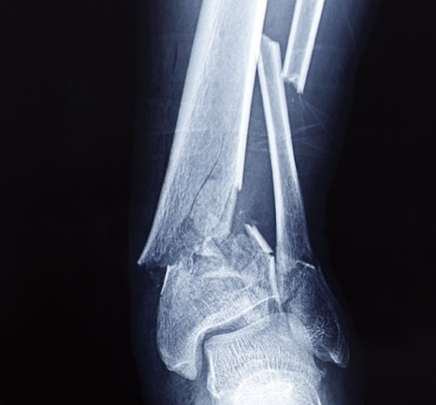
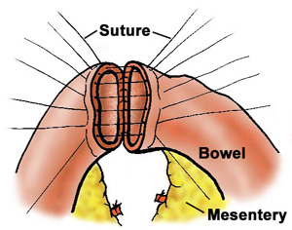
Doctors can ‘fix’ bones with screws and plates and anastomose bowel with sutures. But the fusion of the bone and the reintegration of the bowel are miracles of healing.
Notes:
If we don’t treat a broken bone, it will still heal by itself – as happens in nature. The purpose of orthopedic treatment of fractures is to help the bone heal in proper alignment.
When a surgeon resects a segment of bowel to remove a cancer, the end of the bowel are stitched or stapled together. A week later, the bowel is perfectly joined. Try fixing a garden hose pipe by stitching the cut ends together – when you turn on the water it will spray everywhere! The garden hose doesn’t heal itself, living tissue does.
Another example is lobar pneumonia. The chest x-ray might show the lobe completely solid with pus. We treat with antibiotics to speed recovery but it’s the natural healing process that restores the lung to completely normal structure and function.

Slide 6
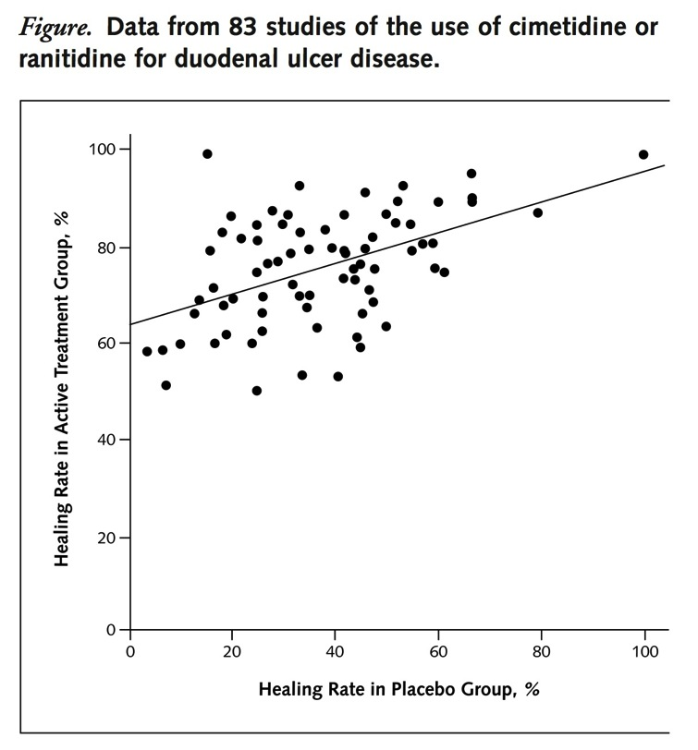
Medical treatment = drug effect + placebo effect
Placebo effect size is equal to drug effect size.
The ‘placebo’ response is not due to inert placebo – it’s a healing response
Active treatment = drug + placebo
Placebo only
Moerman D. Ann Intern Med. 2002;136:471-476.
Notes:
The placebo effect and the nature of randomized, placebo controlled trials is widely misunderstood. Most doctors think that a placebo-controlled trial compares the effects of an active medication with placebo to demonstrate that a treatment is “better than placebo”. The placebo effect is discarded as a “nothingness” – to be ignored, just an annoying interference in the conduct of drug trials. One this basis, many doctors vehemently criticize complementary therapies, such as homeopathy, saying “there is no evidence they work”.
For instance, in the Newsletter of the New Zealand Medical Association that I received today, they state their opposition to Complementary and Alternative (CAM) Therapies: “It is our view that CAMs, currently unregulated in New Zealand, are the antithesis of evidence-based medicine.”
Patients know that many complementary of alternative therapies DO work. How do we explain this difference?
In this excellent paper by Daniel Moerman, he examines the collective results of about 80 randomized-controlled studies of H2 receptor antagonists such as ranitidine (Zantac) in the treatment of peptic ulcer. He points out that in some of the studies, the healing rate in the control group (no active medication) is higher than the healing rate in the treatment group of some other studies! The healing rates tend to correlate: those studies that have a high healing rate in the treatment group also tend to have relatively high healing rates in the control group, and visa versa. How do we explain this correlation? Does the peptic ulcer disease differ in different populations?
Moerman’s explanation is that we should consider the placebo response as a “meaning response” in the patient, where the significance of the treatment as perceived by the patient stimulates a natural healing response. So in some studies, the patients might have been particularly impressed with the prestige of the research institution, the confidence of the treating doctor, the compassion and caring of the staff, the packaging and appearance of the medicine, etc. In other studies, the patients may have felt doubtful about the treatment and unimpressed with the care. We know from research that all these factors powerfully affect the size of the placeo effect.
It’s wrong to say that the placebo controlled trial compared active treatment with placebo. In the placebo arm of the trial, patients get the benefit of the placebo (healing) response and many get better by themselves. In the treatment arm of the trial, patients don’t just get the active treatment (drug) but they also get the placebo (healing) response too. So the outcomes in the treatment are are the SUM of the pharmacological effect and the placebo (healing) effect.
The placebo response is not a “nothingness” – in fact in these studies it’s about equal in size to the drug effect! As the graph shows, the average healing rate in the placebo arm of the trial was a little under 40% ulcers healed. In the treatment arm of the trial, the average healing rate was a little under 80%.
So, when we treat patients, we can combine the effects of active treatment (drug or physical therapy) with the healing response of the placebo. The best doctors bring compassion, caring and great trust to the care of the patient. They get the best results. The worst doctors are so uncaring, arrogant, or blaming of the patient that they produce a harmful ‘nocebo’ response (the oppositive of placebo), which actually counteracts or even cancels out the pharmacological effect of the drug!

Slide 7
The experience of care triggers a powerful biological response in the patient…
…and emotional memories of care last a lifetime
Photo credit: Gus Chan
Notes:
Patients creating meaning from every healthcare encounter, depending on their EXPERIENCE of care. This response can help the patient heal or it can interfere with treatment and recovery.
When patients are sick, injured or vulnerable they get a hugely powerful emotional response within minutes of any encounter with a health professional. These memories often last for a lifetime – either profound gratitude for small acts of kindness, caring and compassion, or deep hurt at being treated in a cruel, unkind or uncaring way – for instance being told a diagnosis of cancer by a clinician who is cold and detached.
These experiences of care trigger a huge cascade of responses in the body, which powerfully affect stress responses, immune system function, pain experience, tissue healing, and many clinical outcomes – see subsequent slides.
I suggest you find your own story to illustrate this point – either a personal experience of care or seeing a loved one receive care. Have the courage to show emotional to your audience (I sometime have tears in my eyes when I tell stories) and to be vulnerable. It will open hearts and minds more powerfully than anything else you can do.

Slide 8
But our medical science is objective, materialistic, reductionist… - we have become ‘body mechanics’, not compassionate healers
Notes:
This slide is self-evident. Just pick up any major medical journal at random and try to find ANY article about care of the whole patient, as opposed to the diagnosis or treatment of pathology.
The word “compassion” is almost completely lacking in the medical literature.
For instance, I searched the entire Pubmed database (which contains 27 million citations) for any article containing the word ‘compassion’, published in the last ten years. I found 2,500 papers. If I do the same search for any article containing the word ‘cardiovascular’, I find 250,000 papers.

Slide 9
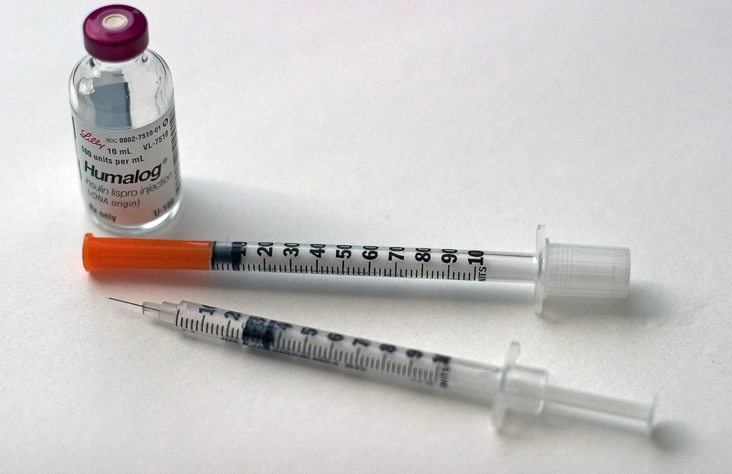
Diabetic patients of high empathy primary care physicians had 42% fewer hospital admissions for metabolic crisis than patients of low-empathy physicians
Photo credit: Sriram Bala
Notes:
Del Canale S, Louis DZ, Maio V, Wang X, Rossi G, Hojat M, et al. The relationship between physician empathy and disease complications: an empirical study of primary care physicians and their diabetic patients in Parma, Italy. Academic Medicine : Journal of the Association of American Medical Colleges. 2012;87(9):1243-9.
Study of 20,000 insulin-dependent diabetics in Italy. All hospital admissions for one years were captured from coding data. Their primary care physicians self-rated their empathy using a standardized physician empathy questionnaire. Those patients cared for by ‘high-empathy’ physicians had 42% fewer acute hospital admissions for diabetic complications.
Note, self-rated physician empathy does not correlate particularly well with patient-rating of physician empathy – some doctors who think they are empathetic may not appear so to their patients.

Slide 10
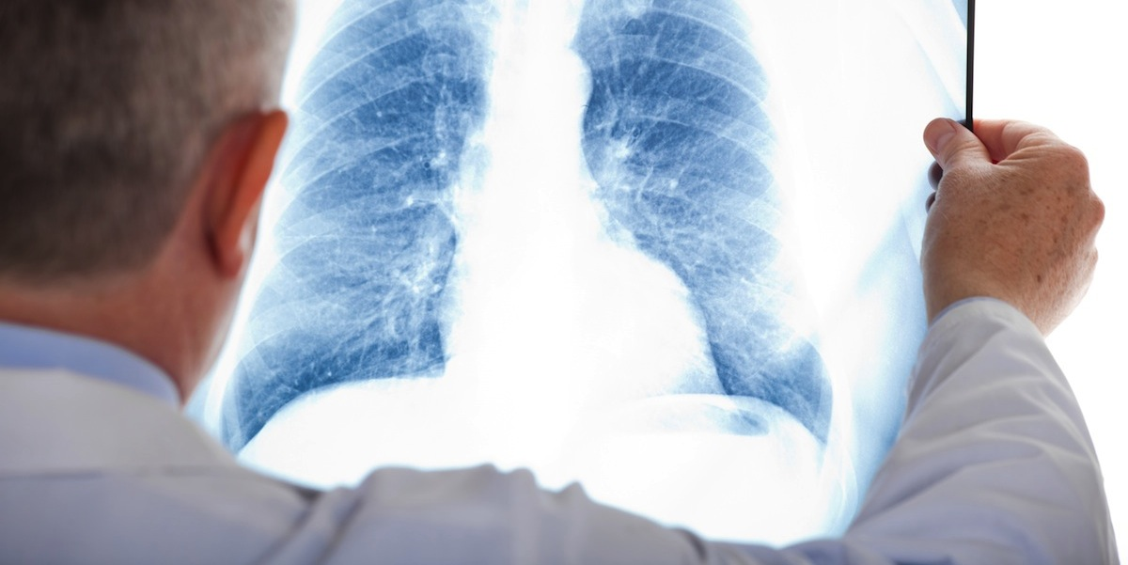
Compassionate, whole-person care in terminal lung cancer – early access to palliative care
Fewer patients have depression, 16% vs 38%
Fewer patients chose aggressive end of life care, 33% vs 54%
Reduced overall cost of care
But increased median survival, 11.6 months vs 8.9 months!
Notes:
Dahlin CM, Kelley JM, Jackson VA, Temel JS. Early palliative care for lung cancer: improving quality of life and increasing survival. Int J Palliat Nurs. 2010;16(9):420-3.
This is a randomised, controlled trial of patients with terminal lung cancer in the USA. All patients had fully-funded access to aggressive medical care including chemotherapy, radiotherapy and palliative surgery. Only half the patients had early access to palliative care, a separately funded cost to the insurance company.
Palliative care physicians provide compassionate, whole person care, would typically talk to patients about their life goals and symptom control, rather than ‘the next round of chemotherapy’. Patients with early access to palliative care had dramatically less depression and better quality of life scores. They appeared to trade off survival time to achieve life goals, turning down aggressive chemotherapy or radiotherapy, perhaps saying, “Sorry doc, I don’t have time for the next round of chemo, I’m going to Australia to see my new grandson!”
A linked paper showed that even through palliative care was an extra cost, the total cost of care fell because patients turned down very expensive treatment such as chemotherapy. The surprising finding was that patients who had palliative care on average survived 30-40% longer than those who chose aggressive medical care.
So in summary, this is compassionate, whole person care that achieves better quality of life, fewer interventions, reduced total cost of care, and prolonged survival.

Slide 11
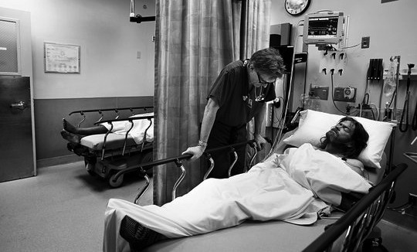
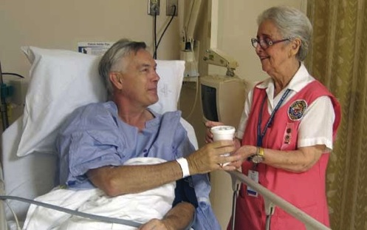
Randomised trial of compassionate care for homeless patients presenting to ER -
30% reduction in repeat visits in next month
Notes:
Redelmeier DA, Molin JP, Tibshirani RJ. A randomised trial of compassionate care for the homeless in an emergency department. Lancet. 1995;345(8958):1131-4.
Abstract
Homeless adults often visit emergency departments and often leave dissatisfied. We tested whether compassionate care, by improving patient satisfaction, can alter subsequent use of emergency services. We identified 133 consecutive homeless adults visiting one inner-city emergency department who were not acutely psychotic, extremely intoxicated, unable to speak English, or medically unstable. Half were randomly assigned to receive compassionate contact from trained volunteers. All patients otherwise had usual care and were followed for repeat visits to emergency departments. We found that rates of use were high, with patients making an average of seven visits a year (0.60 per month). More than a third of all patients made two or more visits within two days of each other. The average number of visits per month after intervention was significantly lower for patients who received compassionate care (0.43 vs 0.65, p = 0.018). Analyses adjusting for each patient's previous rate of use confirmed that compassionate care led to a one third reduction in the number of return visits within one month (95% CI 14 to 40%). Compassionate management of selected homeless adults decreases repeat visits to the emergency department. One explanation is that patients tend to return frequently until they are satisfied with their treatment.
The compassionate contact was simply a volunteer talking with the patient. All patients received ‘usual medical care’ – which begs the question, what is missing from ‘usual’ medical care if merely talking to a volunteer can reduce admissions by 30%

Slide 12
Supportive pre-op visit by anesthesiologist:
- Halved the dose of post-op opiates
Non-supportive pre-op visit by anesthesiologist:
- Length of stay 2.7 days longer
Harvard study 1964: Randomised trial of supportive / non-supportive manner in pre-op visit by anesthesiologist
Notes:
Egbert LD, Battit GE, Welch CE, Bartlett MK. Reduction of Postoperative Pain by Encouragement and Instruction of Patients. A Study of Doctor-Patient Rapport. The New England Journal of Medicine. 1964;270:825-7.
This well-designed, controlled trial at a Harvard hospital was published 50 years ago. As I say, It’s a study of anesthesiologists being nice, or not so nice to patients in the pre-op consultation. All anesthesiologists were randomly assigned to deliver their pre-op consultation according to two different ‘scripts’. One was to carry out the consultation in an expert but clinically detached way (frankly, the way I behaved for most of my career). The second ‘script’ asked the anesthesiologist to perform the same clinical tasks but in addition be more supportive and positive towards the patient – some anesthesiologists might have found this difficult. The outcome measures were ‘total dose of morphine in the five days after surgery’ and ‘average length of stay’.
The finding were extraordinary and maybe hard to believe – however a very similar study was published in 2016 (next slide) and showed major impact on clinical outcomes of an empathetic, supportive pre-op consultation compared with a more detached one.

Slide 13
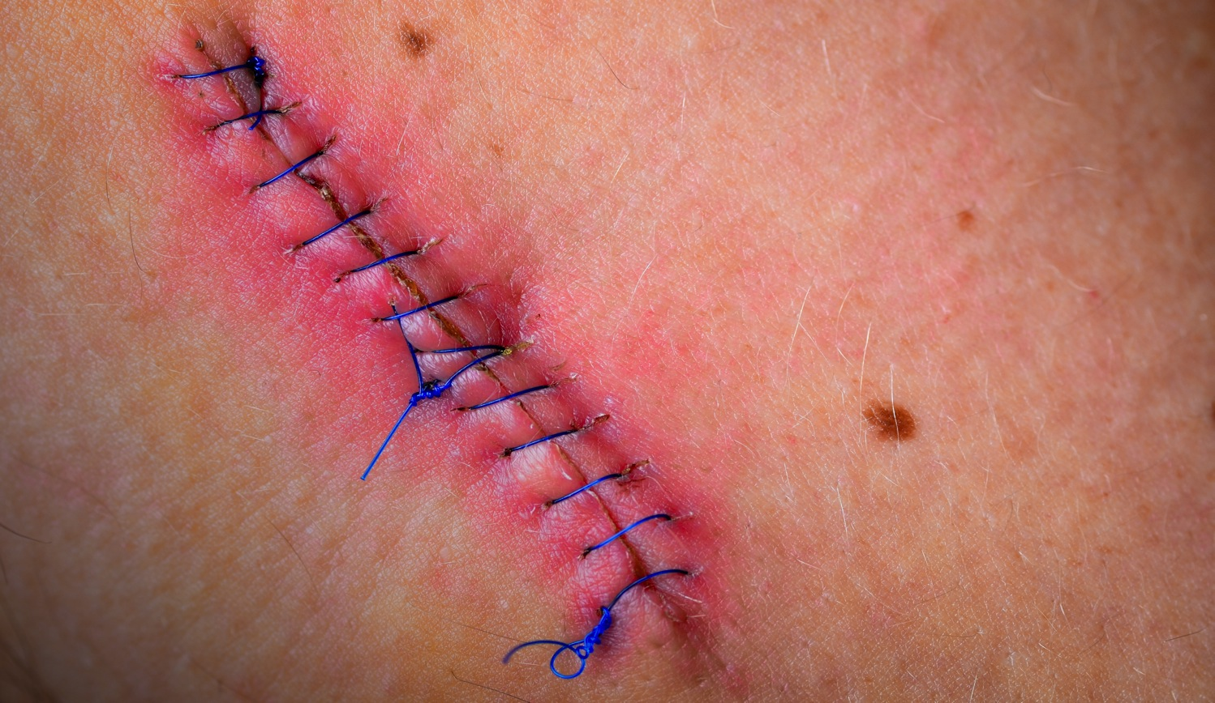
Randomized, controlled trial of empathetic pre-op consultation:
Better wound healing
Better surgical outcomes
Less anxiety
Less pain
Higher levels of daily activities
Preoperative anxiety in ambulatory surgery: The impact of an empathic patient-centered approach on psychological and clinical outcomes. Patient Educ Couns. 2016 May;99(5):733-8.
Notes:
Pereira L, Figueiredo-Braga M, Carvalho IP. Preoperative anxiety in ambulatory surgery: The impact of an empathic patient-centered approach on psychological and clinical outcomes. Patient Educ Couns. 2016;99(5):733-8.
Randomized, controlled trial of 104 patients having ambulatory general surgery. Half the patients had a patient-centered, empathetic consultation, half were just given standardized pre-operative information.
Surgical wound healing was measured objectively, day by day, and was better in patients treated with empathy. Many studies now show that compassionate care makes a very significant difference to objective clinical outcomes, not just subjective measures such as pain and anxiety.

Slide 14
Trauma patients who rated their surgeon “high empathy” are twenty times more likely to fall into the better subjective outcomes group at six weeks after discharge:
Very satisfied with care
Believe that treatment is effective
Treatment makes me feel better
Improved quality of life
Notes:
1. Steinhausen S, Ommen O, Thum S, Lefering R, Koehler T, Neugebauer E, et al. Physician empathy and subjective evaluation of medical treatment outcome in trauma surgery patients. Patient Educ Couns. 2014;95(1):53-60.
OBJECTIVE: To analyze whether patients' perception of their medical treatment outcome is higher among patients who experienced a higher empathy by trauma surgeons during their stay in hospital. METHODS: 127 patients were surveyed six weeks after discharge from the trauma surgical general ward. Subjective evaluation of medical treatment outcome was measured with the corresponding scale from the Cologne Patient Questionnaire. Clinical empathy was assessed by using the CARE measure. The influence of physician empathy and control variables on a dichotomized index of subjective evaluation of medical treatment outcome was identified with a logistic regression. RESULTS: 120 patients were included in the logistic regression analysis. Compared to patients with physician empathy ratings of less than 30 points, patients with ratings of 41 points or higher have a 20-fold higher probability to be in the group with a better medical treatment outcome on the CPQ-scale (alpha-level<.001, R(2) 46.9). CONCLUSION: Findings emphasize the importance of a well-functioning relationship between physician and patient even in a surgical setting where the focus is mostly on the bare medical treatment. PRACTICE IMPLICATIONS: Communication trainings i.e. in surgical education can be an effective way to improve the ability to show empathy with patients' concerns.
This study is important because it shows that even in emergency care – general surgical trauma – it’s not just the technical skills of the surgeon that are important in determining functional and clinical outcomes

Slide 15
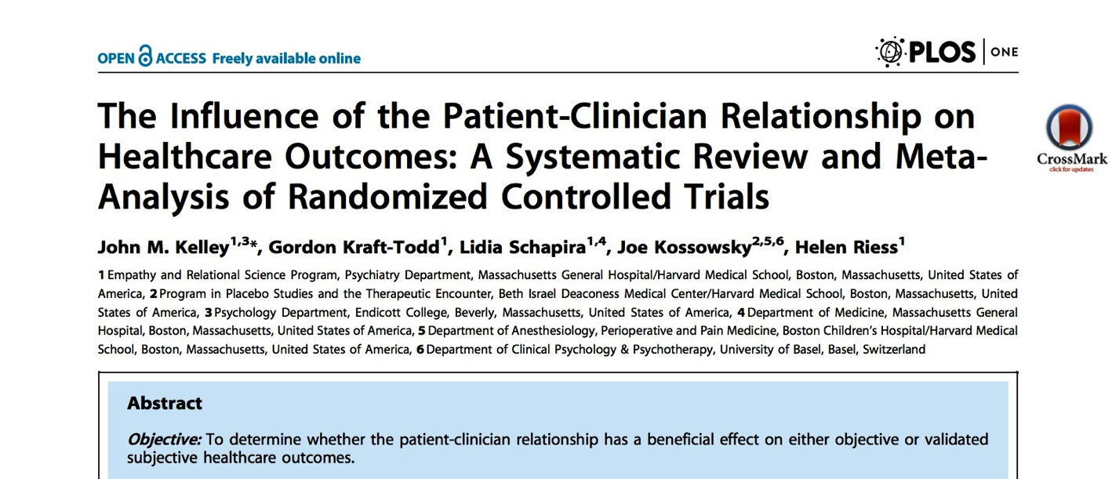
Physician-patient relationship has bigger effect size on 5-year mortality than smoking cessation or taking aspirin.
Notes:
1. Kelley JM, Kraft-Todd G, Schapira L, Kossowsky J, Riess H. The influence of the patient-clinician relationship on healthcare outcomes: a systematic review and meta-analysis of randomized controlled trials. PLoS One. 2014;9(4):e94207.
Helen Riess at Harvard is a world authority on the impact of empathy on clinical outcomes. Her group performed a meta-analysis of the 13 best-designed, randomized, controlled trials that examined whether interventions to improve the relationship between health professional and patient made a difference to objectively measured clinical outcomes.
The answer was “yes”. Although the effect size is relatively small, so are the results of many well-established medical and therapeutic interventions. For instance, they calculated that for a male patient, 5-year cardiovascular mortality would be reduced more by having a caring doctor, than the effect size of smoking cessation, or aspirin therapy.

Slide 16
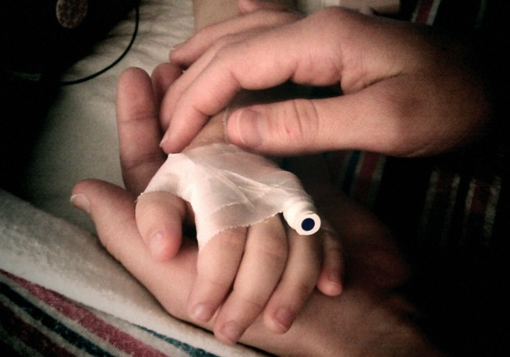
The healing power of touch: - evidence from randomised controlled trials
Reduced pain, reduced cortisol, enhanced immune function in post-op patients
Reduced rate of complications and hospital length of stay in premature infants
Reduced pain levels in multiple studies (meta analysis)
Reduced fatigue and pain in cancer patients
Increased haemoglobin levels in anaemic students
Notes:
Monroe CM. The effects of therapeutic touch on pain. J Holist Nurs. 2009;27(2):85-92.
Marta IE, Baldan SS, Berton AF, Pavam M, da Silva MJ. The effectiveness of therapeutic touch on pain, depression and sleep in patients with chronic pain: clinical trial. Rev Esc Enferm USP. 2010;44(4):1100-6.
Coakley AB, Duffy ME. The effect of therapeutic touch on postoperative patients. J Holist Nurs. 2010;28(3):193-200.
Movaffaghi Z, Hasanpoor M, Farsi M, Hooshmand P, Abrishami F. Effects of therapeutic touch on blood hemoglobin and hematocrit level. J Holist Nurs. 2006;24(1):41-8.
Multiple studies demonstrate the healing effect of human touch, including massage therapy and Therapeutic Touch. In modern times, where there is so much concern about cross-infection, many patients never receive direct skin-to-skin contact from health professionals. In my own practice, I wash hands carefully before each patient and often apply a comforting touch to anxious patients.

Slide 17
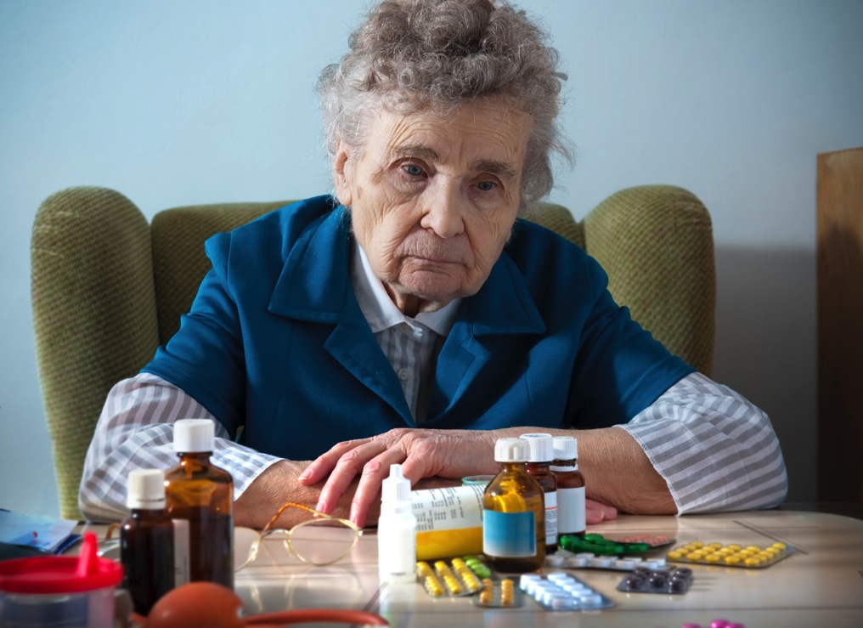
Compassionate caring can be as powerful as the drugs we use…
Our thoughts, feelings and intentions change the biology of our patients
Notes:
As a health professional I have learned to be exquisitely sensitive to the spirit I bring to each patient encounter. I pause before I meet the patient and make sure I am calm, centered, mindful and ready to bring compassion and kindness to the patient. I met one inspiring nurse who worked in a busy ER. She said, “I want to give every patient the impression that he or she is the only patient in the world, that all my focus is on their care. I put out of my mind all the other patients and all the other tasks I have to do.”

Slide 18
Compassionate caring is safer, more effective, satisfies patients, saves time, reduces demand, gives meaning to work, and costs less
Notes:
Summary slide

Slide 19
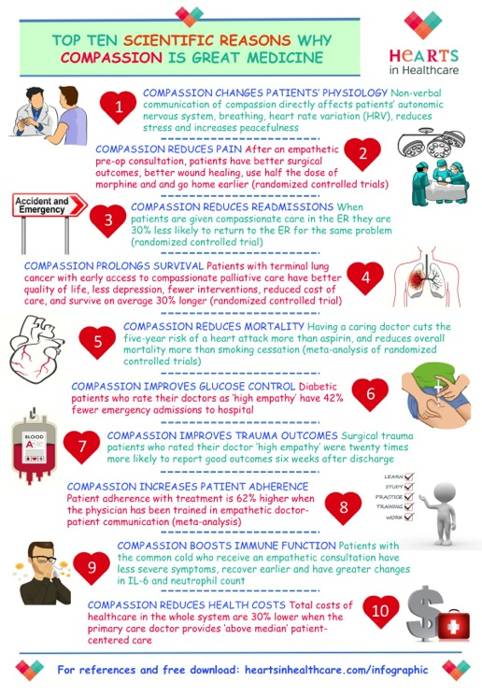
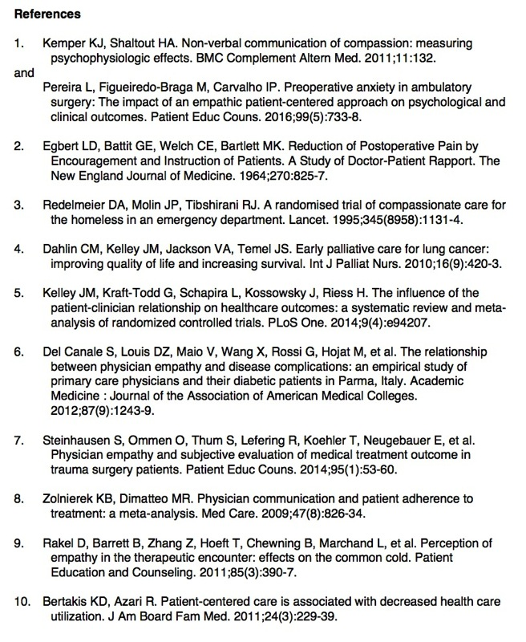
heartsinhealthcare.com/infographic
Notes:
If people want a handy summary of the evidence, Hearts in Healthcare created this nice info-graphic together with all of the references. Anyone can download this file and use it for their own purposes

Slide 20
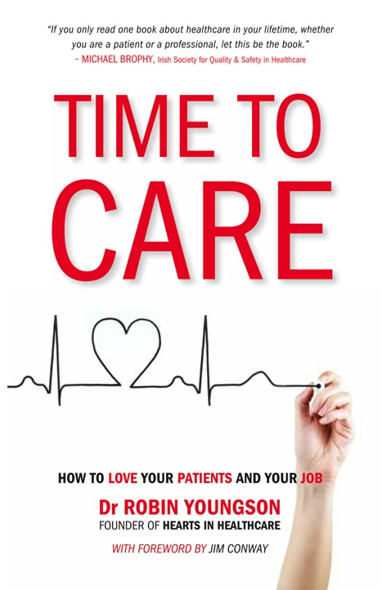
The scientific evidence for all these claims can be found in the book that launched Hearts in Healthcare
Notes:
TIME TO CARE was published in 2015 and has helped many health professionals renew their commitment, find joy in their work, recover from burnout, and even save their careers. It also published in Dutch and German and the Hungarian edition is coming out in October 2017. The paperback and pdf versions can be ordered from the Hearts in Healthcare website and it’s also on Amazon as a Kindle and paperback.

Slide 21
{the movement for human-centred healthcare}
heartsinhealthcare.com
Notes:
This is our website link

Slide 22
References
1. Seligman MEP. Positive Health. Applied Psychology: An International Review N. 2008;57:3-18.
2. Toker S, Melamed S, Berliner S, Zeltser D, Shapira I. Burnout and risk of coronary heart disease: a prospective study of 8838 employees. Psychosomatic medicine. 2012;74(8):840-7.
3. Perroud N, et al. Response to psychotherapy in borderline personality disorder and methylation status of the BDNF gene. Transl Psychiatry. 2013 Jan 15;3:e207. doi: 10.1038/tp.2012.140.
4. Tryggvadottir L et al. Population-based study of changing breast cancer risk in Icelandic BRCA2 mutation carriers, 1920-2000. J Natl Cancer Inst. 2006 Jan 18;98(2):116-22.
5. Riess H, Kelley JM, Bailey RW, Dunn EJ, Phillips M. Empathy Training for Resident Physicians: A Randomized Controlled Trial of a Neuroscience-Informed Curriculum. Journal of General Internal Medicine. 2012;27(10):1280-1286. doi:10.1007/s11606-012-2063-z.
6. Del Canale S, Louis DZ, Maio V, Wang X, Rossi G, Hojat M, et al. The relationship between physician empathy and disease complications: an empirical study of primary care physicians and their diabetic patients in Parma, Italy. Academic Medicine : Journal of the Association of American Medical Colleges. 2012;87(9):1243-9.
7. Dahlin CM, Kelley JM, Jackson VA, Temel JS. Early palliative care for lung cancer: improving quality of life and increasing survival. Int J Palliat Nurs. 2010;16(9):420-3.
8. Redelmeier DA, Molin JP, Tibshirani RJ. A randomised trial of compassionate care for the homeless in an emergency department. Lancet. 1995;345(8958):1131-4.
9. Egbert LD, Battit GE, Welch CE, Bartlett MK. Reduction of Postoperative Pain by Encouragement and Instruction of Patients. A Study of Doctor-Patient Rapport. The New England Journal of Medicine. 1964;270:825-7.
10. Kelley J1, Kraft-Todd G, Schapira L, Kossowsky J, Riess H. The influence of the patient-clinician relationship on healthcare outcomes: a systematic review and meta-analysis of randomized controlled trials PLoS One. 2014 Apr 9;9(4):e94207.
11. Monroe CM. The effects of therapeutic touch on pain. J Holist Nurs. 2009;27(2):85-92.
12. Marta IE, Baldan SS, Berton AF, Pavam M, da Silva MJ. The effectiveness of therapeutic touch on pain, depression and sleep in patients with chronic pain: clinical trial. Rev Esc Enferm USP. 2010;44(4):1100-6.
13. Coakley AB, Duffy ME. The effect of therapeutic touch on postoperative patients. J Holist Nurs. 2010;28(3):193-200.
14. Stewart M, Brown JB, Donner A, McWhinney IR, Oates J, Weston WW, et al. The impact of patient-centered care on outcomes. J Fam Pract. 2000;49(9):796-804.
15. Bertakis KD, Azari R. Patient-centered care is associated with decreased health care utilization. J Am Board Fam Med. 2011;24(3):229-39.
16. Decety J. The Neurodevelopment of Empathy in Humans. Developmental Neuroscience. 2010;32(4):257-67.
17. Youngson R. Time to Care: How to love your patients and your job. Raglan: Rebelheart Publishers; 2012.
Notes:
These are the main references I use in my presentations but this is not the entire list. Each slide in this set has the full reference in the notes.

