Slide 1
Choose to love your work
heartsinhealthcare.com/choose-to-love-your-work/
Notes:
A Hearts in Healthcare article on the website: http://heartsinhealthcare.com/choose-to-love-your-work/

Slide 2
How to be a happy health professional?
Practicing kindness, appreciation and gratitude
Choosing to love your work
Self-compassion
Building positivity and resilience
Mindfulness
Notes:
Hearts in Healthcare identified and interviewed health professionals who were joyous and flourishing in their work, even in work settings where other health workers were burning out. These two slides identifying some of the their characteristic practices.
Rather than teaching about these aspects, it’s great to draw out the knowledge and wisdom among your peers in a workshop process. Simply show these two slides and ask people if any of the elements are things or practices they identify with, or practice.

Slide 3
How to be a happy health professional?
Letting go of being the expert
The gift of time
Spiritual growth
Personal service
Non-judgment
Sharing your vulnerability
Notes:
Hearts in Healthcare identified and interviewed health professionals who were joyous and flourishing in their work, even in work settings where other health workers were burning out. These two slides identifying some of the their characteristic practices.
Rather than teaching about these aspects, it’s great to draw out the knowledge and wisdom among your peers in a workshop process. Simply show these two slides and ask people if any of the elements are things or practices they identify with, or practice.

Slide 4
There’s no compassion without self-compassion
Notes:
People with high levels of self-criticism and self-judgment are often critical and judgmental of others including patients and colleagues. As healers, our first job is to heal ourselves. When we become kind and compassionate towards ourselves, we tend to be kinder and more compassionate to others.
Google search the work by Kristen Neff on self-compassion to find free resource (her book is pictured in one of the other slides)

Slide 5
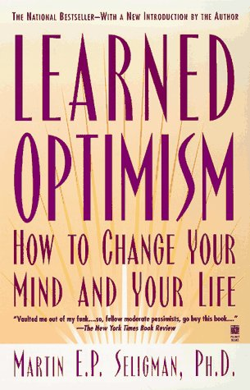
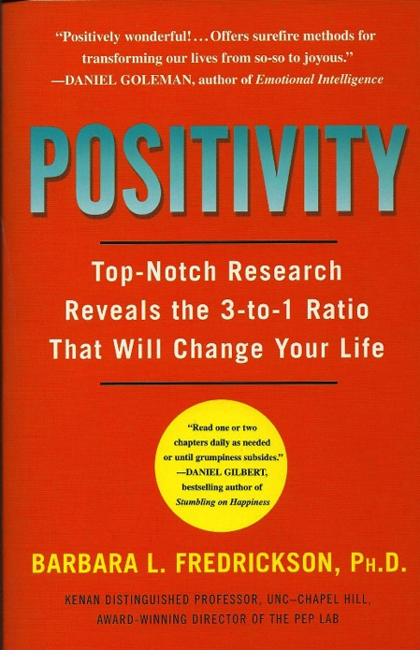
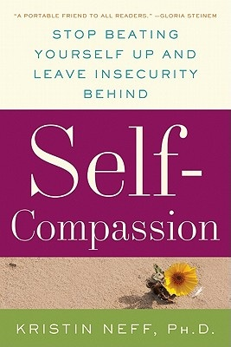
Notes:
Three great books on self-care and positivity based on rigorous scientific research and evidence. If you are teaching about compassion or self-care you should be familiar with these texts. I use the knowledge gained from these books, every single day of my life.

Slide 6
Compassion for nature
Compassionate communities
Compassion for others
Self- compassion
Notes:
I use this slide with health leaders. I say, you can’t expect your employees to treat patients with compassion unless they are also treated with compassion as employees. As a leader, it’s your job to role model self-compassion and compassion for others. Positive role models are the most influential way to change the culture of an institution.

Slide 7
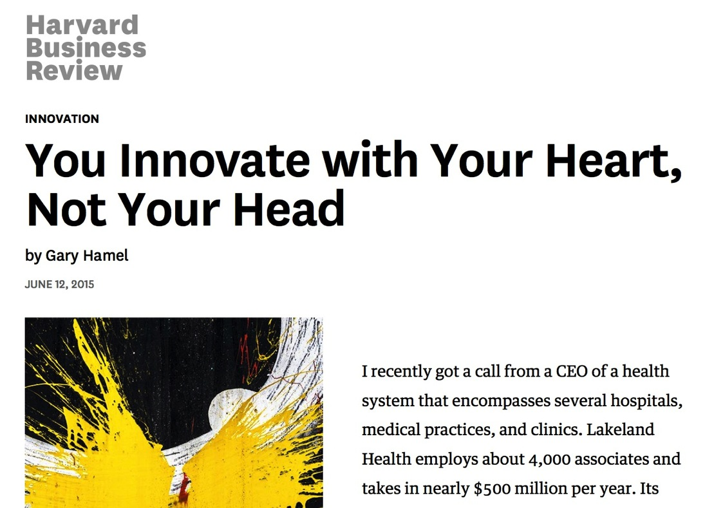
Notes:
https://hbr.org/2015/06/you-innovate-with-your-heart-not-your-head
This article, from the Harvard Business Review, and written by a very prominent business/leadership guru tells the story of complete organisational transformation when the CEO asked every employee to bring their heart to work each day. Patient satisfaction scores went from 25-50% percentile to the 90% percentile in just three months. There was no training program.
Read the article to be inspired, then share the story.

Slide 8
Empathy can be taught: Helen Riess randomised controlled trial of resident training
Three sixty-minute modules
Neurobiology and physiology of emotions and empathy training
Physiology of emotions during difficult patient encounters
Skill in decoding subtle facial expressions
Empathic verbal and behavioural responses
Self-regulation skills with breathing exercises and mindfulness
Notes:
Riess H, Kelley JM, Bailey RW, Dunn EJ, Phillips M. Empathy training for resident physicians: a randomized controlled trial of a neuroscience-informed curriculum. J Gen Intern Med. 2012;27(10):1280-6.
This study shows that training can enhance empathy in medical residents and that it improves the patient’s perception of the doctor’s empathy and caring as measured by the Consultation and Relational Empathy (CARE) questionnaire.

Slide 9
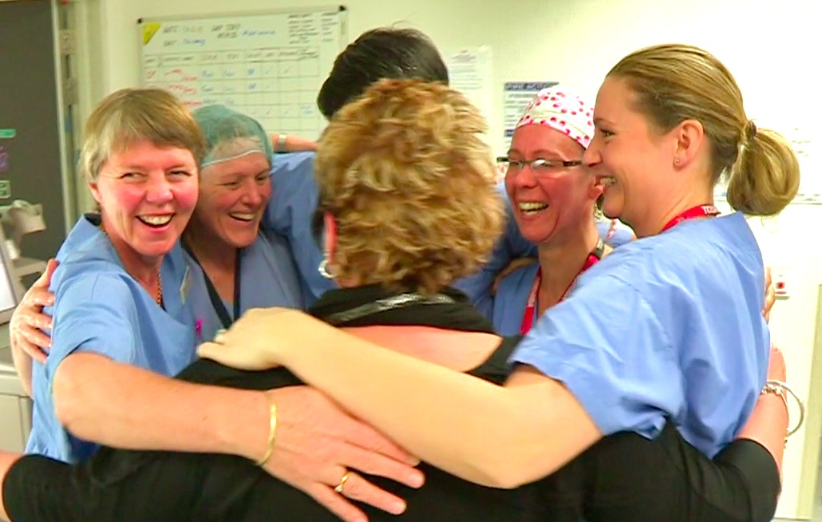
Number 1 priority: Health and wellbeing of health professionals
Notes:
A powerful message for all health leaders.

Slide 10
The health professionals who flourish in the broken system are those who learn and practice the daily habits of…
kindness appreciation gratitude
mindfulness
self-compassion
choosing to love their work
Notes:
Self-explanatory

Slide 11
Flexible empathy – the key to resilience?
Notes:
Flexible empathy is a useful concept. When we develop the skills of mindfulness, we can skillfully direct our attention and feelings to the task at hand. For instance, in an emergency or resuscitation situation, you must act very swiftly to save a life and you can’t afford to let your emotions cloud your judgment or inhibit necessary actions. In fact, neuroscience shows that a focus on cognitive tasks blunts empathy, and a focus of empathy and feelings blunts cognitive performance so we must learn to employ the mental functions according to the needs of the situation.
After a successful resuscitation, your next task is to meet with the anxious and fearful relatives of the patient. This is the time to turn off the technical and cognitive processes and concentrate on empathy and compassion.
Practitioners who don’t learn the flexibility are at risk of burnout – either from being always overwhelmed by negative feelings, or else from a state of detachment where they lose the meaning and joy of human connection (and cause harm to patient and family members with their coldness and detachment).

Slide 12
OLD STORY…
I am a helpless victim of ‘the system’
I am powerful to change the world through my attitude, beliefs and stories
NEW ASSUMPTIONS…
… NEW STORY
Notes:
See my blog on the Hearts in Healthcare website: http://heartsinhealthcare.com/choose-to-love-your-work/
Then find our own story to illustrate the point.

Slide 13
Remembering our purpose…
..dreaming of being a healer
Notes:
A personal slide for me, remembering my life-long dream of being a healer. Compassion taps into the deepest motives and ideals of health professionals

Slide 14
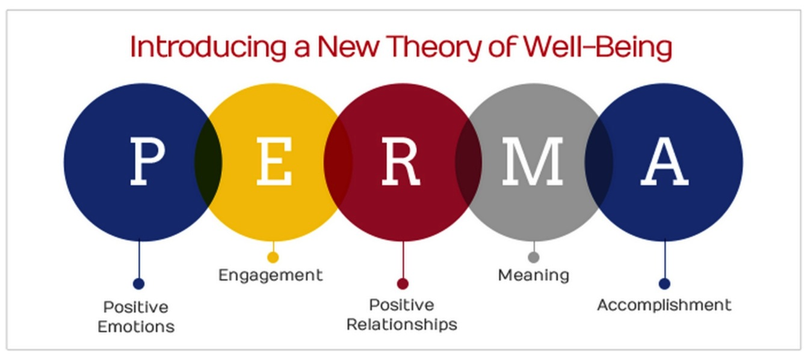
“Flourish: A visionary new theory of happiness and wellbeing” – Martin Seligman
https://www.authentichappiness.sas.upenn.edu/learn
Notes:
https://www.authentichappiness.sas.upenn.edu/learn
Martin Seligman, the founding father of positive psychology, has developed a comprehensive framework for human flourishing and wellbeing – these are the elements.

Slide 15
You begin your career as a novice. But every health professional, from day one, has a fully formed heart. Let compassion be your great strength
Notes:
Health professionals often feel incompetent and vulnerable in their training and early years of practice. Reminding them of the importance of compassion and how profound it impacts on clinical outcomes, lets every health worker realize they have a great strength.

Slide 16
Five daily practices that can transform your life…
Choose your thoughts on your journey to work
Small acts of kindness
Making the human connection
Find out first your patient’s concerns
Treat every patient like a family member
Photo credit: Lewishamdreamer
Notes:
These are five simple practices that can transform your work.
Choose your thoughts. Choose to dwell on the extraordinary privilege of the work we do each day, and the joy of human connection, rather than endlessly ruminating on all the things that make us feel dissatisfied.
Come to work each day with the deliberate intention to d at least one small act of kindness
Make the human connection with all your patients before you treat them as a patient
Find out first your patient’s concerns and address those before you get busy with your own agenda for care
Try to treat each patient with the same kindness you would give to a family member.

Slide 17
If you want others to be happy, practice compassion. If you want to be happy, practice compassion.
Ancient wisdom – the Golden Rule of Compassion
If you want others to be healthy, practice compassion. If you want to be healthy, practice compassion.
Notes:
Ancient wisdom, the Golden Rule sits at the heart of all religious traditions.

