Slide 1
TITLE
Subtitle
Presenter name

Slide 2
The critical importance of compassion in patient care
Presenter

Slide 3
Title
Presenter

Slide 4
The heart of healing – a compassionate approach to mental illness
Dr Robin Youngson Co-Founder of Hearts in Healthcare

Slide 6
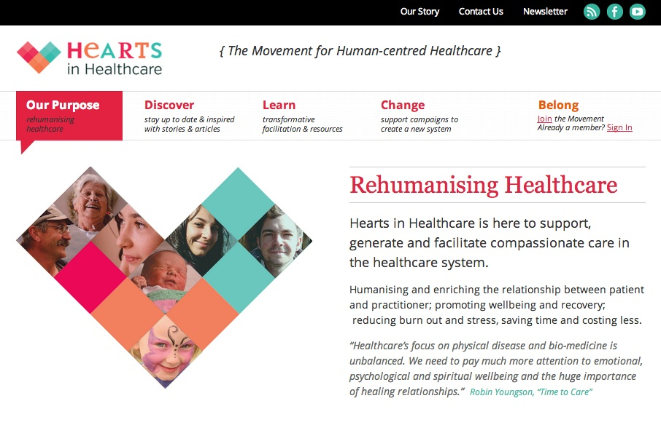

Slide 7
{the movement for human-centred healthcare}
heartsinhealthcare.com
robin@heartsinhealthcare.com

