Slide 1
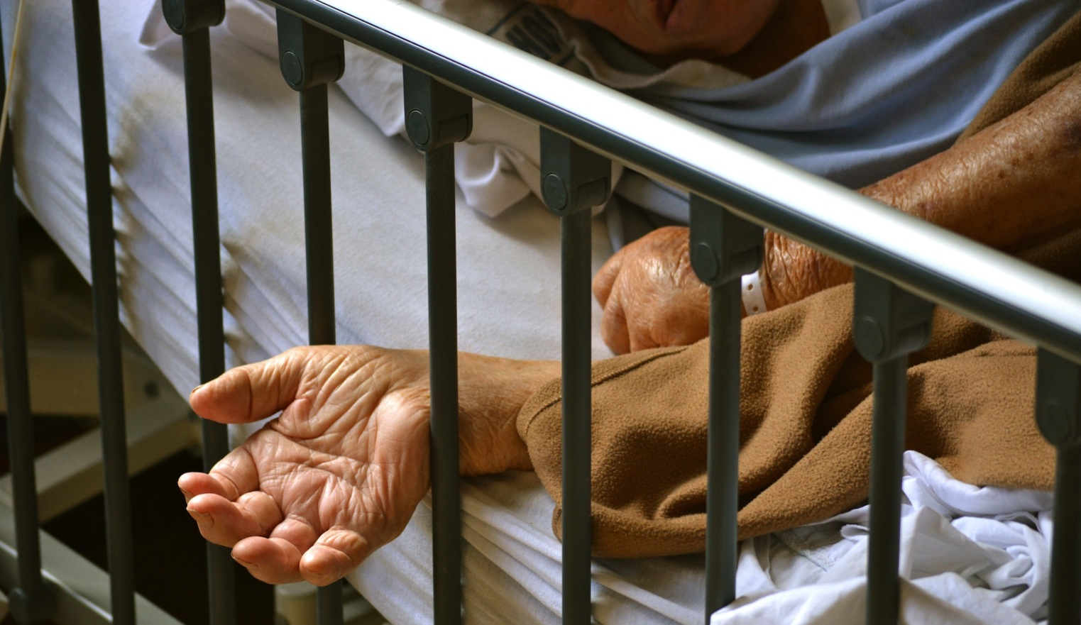
Compassion is the calling that brought us into the healing professions – knowing suffering and wanting to do something about it
Notes:
This is the simplest definition of compassion. I say to audiences, “I’m pretty sure this is why all of you are here – you were drawn in healthcare work because you wanted to respond to suffering in the world and to care for people”.
Compassion is not just a feeling, it’s a motivation.
People do confuse terms like empathy, sympathy, compassion and pity. Compassion has the element of non-judgment, we can be compassionate to someone we don’t like or approve of. On the other hand we tend not to sympathize with people we judge don’t deserve our sympathy, such as someone who is violent, or a drunk driver – so sympathy also involves judgment.
People don’t want pity because that also involves judgment – the person offering pity feels superior to the one who is pitied.
The distinction between empathy and compassion is extremely important – see the next slide.

Slide 2
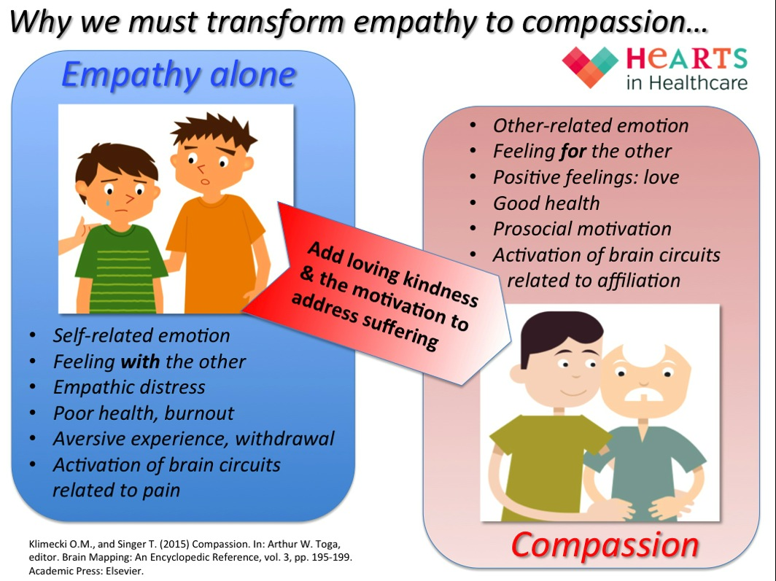
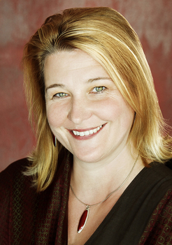
Professor Tania Singer, Director, Department of Social Neuroscience, Max Planck Institute for Human, Cognitive and Brain Sciences, Leipzig
Notes:
In the literature we see many calls for more empathy in medicine, nursing practice or healthcare and a lot of the research is based on measures of empathy rather than compassion. I think this is unhelpful.
Empathy does not have a moral value, it is not necessarily a motive for good. Conmen use empathy to build your trust before stealing all your money. Torturers use empathy to increase the suffering and pain of their victims. On the other hand, compassion has a strong moral value and it’s always a force for good.
Empathy is a human ability to intuit and understand another’s emotions (emotional empathy), their situation or problem (cognitive empathy), and also body reactions (visceral empathy). Empathy is not restricted to pain or suffering – we can also empathize with happiness or joy. Empathy is a skill and can be developed. In the practice of empathy, we understand and mirror people’s emotional state, summarize and feed back our understanding of their situation or story, and react to body signals such as nausea, retching, pain, fatigue or yawning.
Tania Singer is a famous neuroscientist at the Max Planck Institute in Germany. She has studied the difference between empathy and compassion using brain scans in experienced meditators and ordinary subjects. When we empathize with someone in pain or suffering, our own pain circuits light up in the brain scan – we literally feel the pain of others. This is associated with brain circuits connected to negative affect (feeling) and the experience is aversive, we want to turn away because the experience is painful.
Empathy is transformed to compassion with a kind of alchemy when we add two crucial elements: an attitude of loving kindness and a motivation to address the suffering of the other. Completely different brain circuits light up, those associated with positive affect (warm feelings) and the circuits concerned with human bonding and affiliation. So every act of compassion is also compassion for self as well as the other. In deep compassion, we can witness the pain and suffering of others without being wounded. Compassionate practice is sustainable, whereas empathy alone can lead to burnout.
To sustain lifelong compassion there are some necessary pre-conditions: we must practice self-compassion and non-judgment; we must live a balanced lifestyle, nourish ourselves and not overwork; and we must let go of attachment to the outcomes of our work.
Compassion with non-attachment (emotionally warm) is very different from clinical detachment (emotionally cold). Non-attachment is a humble stance recognizing that many factors other than our care will determine the outcome for the patient and it doesn’t imply a lack of personal responsibility – on the contrary, compassionate practitioners bring great clarity and skill to their practice and achieve better clinical outcomes than practitioners who are emotionally detached.

Slide 3
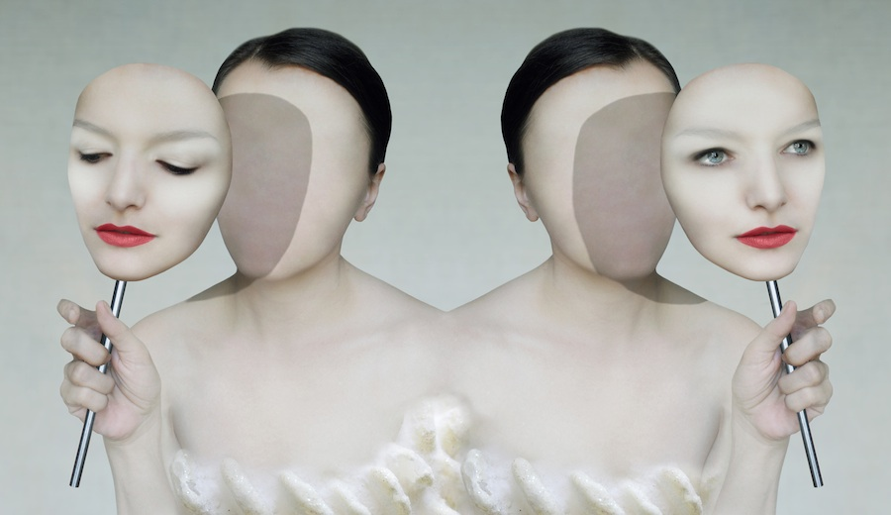
Flexible empathy – the key to resilience?
Notes:
Flexible empathy is a useful concept. When we develop the skills of mindfulness, we can skillfully direct our attention and feelings to the task at hand. For instance, in an emergency or resuscitation situation, you must act very swiftly to save a life and you can’t afford to let your emotions cloud your judgment or inhibit necessary actions. In fact, neuroscience shows that a focus on cognitive tasks blunts empathy, and a focus of empathy and feelings blunts cognitive performance so we must learn to employ the mental functions according to the needs of the situation.
After a successful resuscitation, your next task is to meet with the anxious and fearful relatives of the patient. This is the time to turn off the technical and cognitive processes and concentrate on empathy and compassion.
Practitioners who don’t learn the flexibility are at risk of burnout – either from being always overwhelmed by negative feelings, or else from a state of detachment where they lose the meaning and joy of human connection (and cause harm to patient and family members with their coldness and detachment).

Slide 4
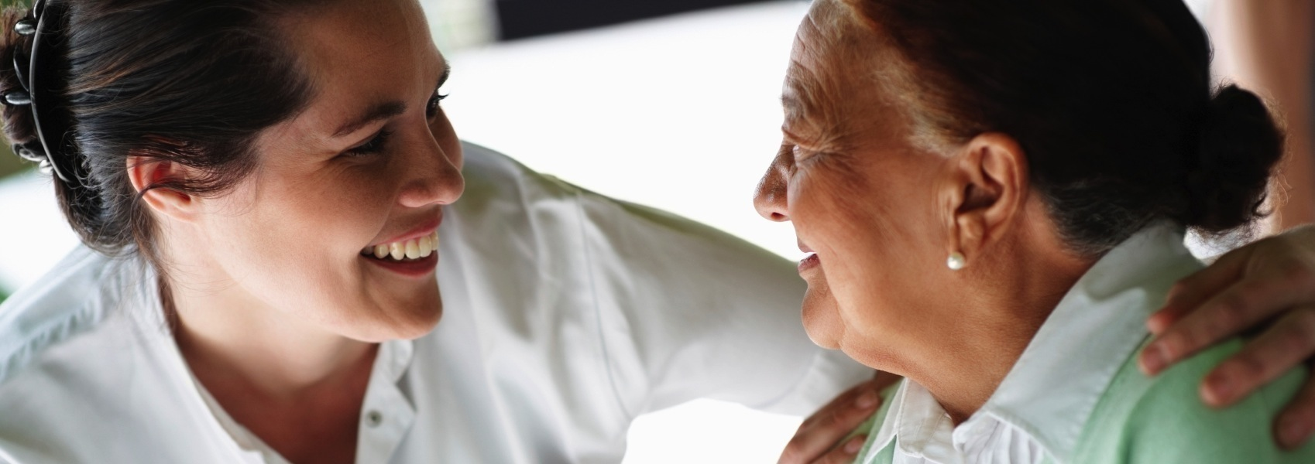
The science of interpersonal connection
Notes:
Clinical detachment is largely a myth: it does not help you be more objective, make better decisions, or protect you from traumatization. Human beings are intimately connection. Practitioners who learn the skill of open-hearted compassion with non-attachment to outcomes make better clinical decisions, understand their patients better and actually protect themselves from emotional traumatization.
Our brains have specialized, rapidly acting neurons called ‘mirror neurons’, which can recognize and interpret a facial expression within 1/20th of a second. We can demonstrate this capacity by flashing subliminal images of face with different expressions on a computer screen. Most people will intuit a feeling, for instance of anger, or sadness, or disgust even though they didn’t consciously see the image. The mirror neuron system is the basis of empathy and it also interprets body posture, tone of voice and other non-verbal clues to intuit intention.
So powerful is this connection, neuroscientist have had to create a whole new field of science called ‘inter-personal neurobiology’, which describes for instance how a mother and baby continually restructure each other’s neural networks. I often joke with audiences to say, “I’m really going to mess with your minds – by the end of this lecture I will have changed the structure of your brain!”
The second way that people are connected is a direct electro-mechanical coupling from the electrical field of the heartbeat – the thing we record every time we do an ECG (EKG). This electrical field extends meters beyond the body and directly affect neuronal function of people close to us. If we connect an ECG monitor to one subject and an EEG monitor to another subject, to measure brain waves, we can find evidence that some neurons in the second subject are fifing in synchrony with the heartbeat of the first subject, and visa versa. We literally have a heart-felt connection.
The heart is a sense organ and has an extensive neural network with about 3,000 neurons. More signals go from the heart to the brain than from the brain to the heart. There is a state called ‘physiological coherence’ associated with calm mindfulness and compassion in which the heart and the brain work together. This state can easily be detected by analyzing fine variations in the beat-to-beat interval (so-called Heart Rate Variation HRV) and you can even get an app on you smart phone to do this analysis.
This calm state of physiological coherence is actually contagious. So when I have an anxious patient I can change their physiology and reduce their heart rate and blood pressure simply from my own calm and compassionate state – without even saying a word or giving a drug. This elicits a healing response in the patient, which can profoundly change clinical outcomes.
What this means is that we have a kind of broadband wifi connection between ourselves and our patients, which can do good or harm – see next slide.

Slide 5
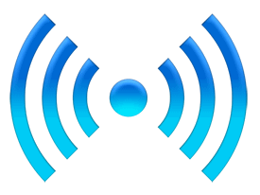
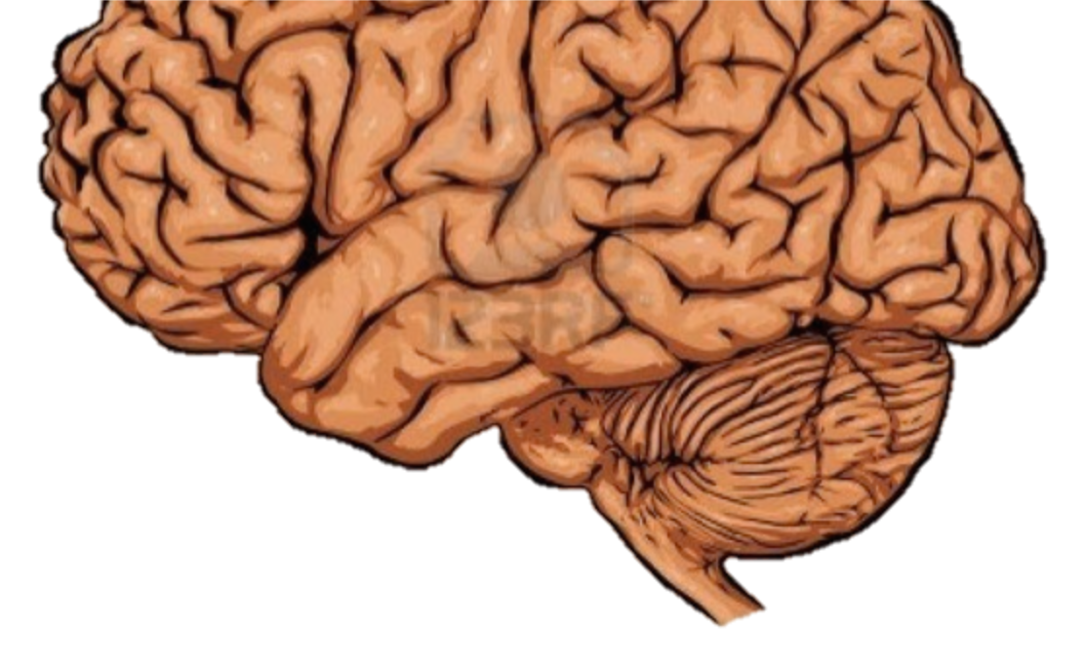
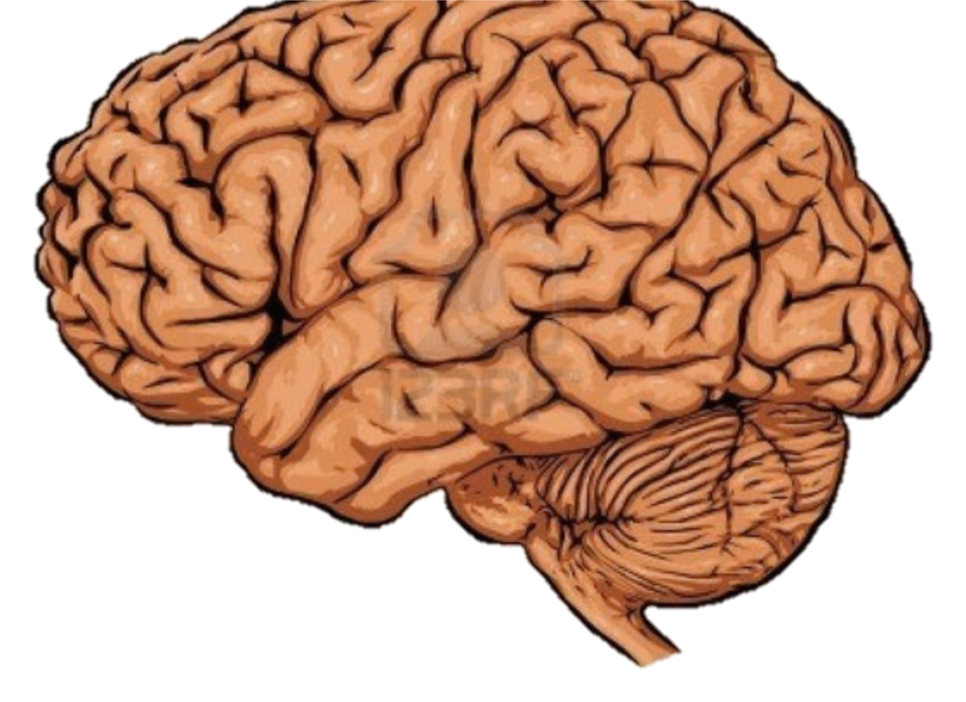
wounding
Cascading reactions in the healing response…
wellness genes up-regulated new protein synthesis tissue healing enhanced immunity lowered blood pressure positive emotions
cancer genes activated stress hormones tissue breakdown compromised immunity raised blood pressure negative emotions
Notes:
When we bring a compassionate spirit to our patients, we elicit a wide cascade of healing responses including new gene expression, new protein synthesis, enhanced tissue healing, enhanced immunity, a reduction in inflammatory and stress responses, and a positive emotional experience that may be remembered for a lifetime. Every time the patient remembers that care, the whole healing cascade is switched on again.
Conversely, if we are angry, frustrated, judgmental or cold to our patients, we actually wound them, causing a similar cascade of harmful changes.
The compelling evidence for all these effects is contained in the slide collection about Clinical Outcomes.

Slide 6
The science of interpersonal connection
Notes:
Alternative version of slide for pediatrics

Slide 7
wounding
Cascading reactions in the healing response…
wellness genes up-regulated new protein synthesis tissue healing enhanced immunity lowered blood pressure positive emotions
cancer genes activated stress hormones tissue breakdown compromised immunity raised blood pressure negative emotions
The science of interpersonal connection
Notes:
Alternative version of slide for pediatrics

