Slide 1
These slides are not in any particular order and they are gathered together from several different presentations.
Please just select the slides relevant for your presentation and delete the rest. Copy and paste a title slide and selected slides from the other collections in the slide bank, and add your own slides, stories, wisdom and knowledge
Don’t forget to edit the ‘Slide Master’ to complete the top of the slide – this will show on all the slides.

Slide 2
Emotional trauma affects our gene expression
In patients who responded to psychotherapy for Borderline Personality Disorder, improvement was associated with up-regulation of the gene for brain-derived neurotrophic factor (BDNF).
Our life experiences, beliefs and internal stories dynamically change our gene expression, altering health outcomes.
Notes:
1. Perroud N, Salzmann A, Prada P, Nicastro R, Hoeppli ME, Furrer S, et al. Response to psychotherapy in borderline personality disorder and methylation status of the BDNF gene. Transl Psychiatry. 2013;3:e207.
Downregulation of brain-derived neurotrophic factor (BDNF) gene expression with corresponding increased methylation at specific promoters has been associated with stressful experiences in early life and may explain later adulthood psychopathology. We measured the percentage of methylation at BDNF CpG exons I and IV as well as plasma BDNF protein levels in 115 subjects with borderline personality disorder (BPD) and 52 controls. BPD subjects then underwent a 4-week course of intensive dialectical behavior therapy (I-DBT).
Therapy responders showed a decrease in methylation status over time. Accordingly, the changes in methylation status over time were significantly associated with changes in depression scores, hopelessness scores and impulsivity.
Borderline Personality Disorder is associated with high levels of self harm and suicide. Fortunately, more than 80% of patients respond to Dialectal Behaviour Therapy, which is psychotherapy based on mindfulness, recognition of emotions, skills in emotional regulation and relationship. Some are permanently cured of the condition. What this study shows is that childhood emotional trauma causes down-regulation of the gene that makes an essential brain growth factor – the brain develops in a structurally abnormal way and the net result is an inability to regulate emotions. Therapy up-regulates the gene, turns on the brain growth factor and restructures the brain circuits, potentially curing the condition.

Slide 3
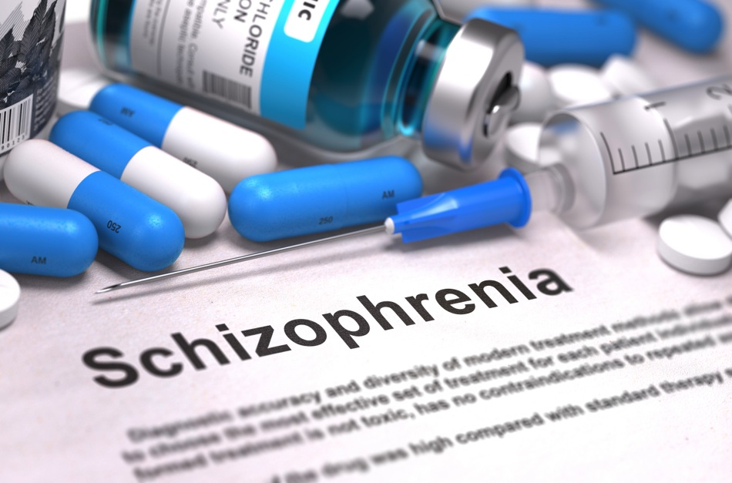
Compassion means honouring the whole person
Notes:
Psychiatry is dominated by a bio-medical model where mental illness is seen as an ‘imbalance’ of brain chemicals, which needs to be treated with drugs. This approach classifies many human experiences as ‘pathological’. DSM-5 (Diagnostic and Statistical Manual of Mental Disorders, version 5) lists 297 ways that people can be mad, bad or sad even though many of the described ‘pathologies’ are healthy expression of the whole range of the human condition. This classification system is reinforced by insurance companies who will not reimburse treatment expenses unless there is a DSM code attached to the claim.
The definition of mental illness is wholly culturally determined – a set of behaviors that are deemed to be unacceptable or deviant from social or cultural norms. Thus experiences like ‘hearing voices’ is deemed a psychotic illness in Western culture but may be entirely normal in other cultures. In young adults presenting with a first episode of ‘psychosis’ rather than treating this as a pathology that requires drug treatment, an alternative approach is to regard the experience as a spiritual crisis or spiritual emergency where profound aspect of identity, belief and meaning are being tested. Supportive therapy, which minimalizes the use of drugs, leads to full recovery in many patients without relapse. On the other hand, conventional treatment with at least six months of anti-psychotic drug therapy often leads to life-time illness with repeated psychotic episodes and hospital admissions.
Labeling experiences as ‘pathological’ or ‘not real’ denies aspects of the whole person. I had a friend in her twenties who had repeated admission to hospital with a diagnosis of schizophrenia and symptoms of acute psychosis. On her last admission she met a deeply compassionate psychiatrist who treated all her experiences as real, showed great compassion for her suffering, and helped her reintegrate all her experiences into an integral self of whole self. She was never admitted to hospital again and was able to wean off medications.
In a similar vein, for patients with dementia we tend to spend a lot of time correcting their mistaken beliefs, which causes distress and humiliation. On the other hand, if we step in to the realty of the person with dementia and act with compassion, without trying to correct beliefs, much of the agitation and distress is diminished.

Slide 4
Compassion means supporting the families
Notes:
Family members bear the brunt of caring for people with serious mental illness, whether it’s depression, self-harm, suicide attempts, mania or psychotic illness. In our experience, families are often given no support or education at all.
For instance, parents of suicidal teens or young adults may go through months or years of harrowing experience trying to support their loved ones and to keep them alive. There may be an overwhelming burden of anxiety, fear, shame, depression and emotional exhaustion.
Teaching family members simple techniques like ‘emotional validation’ can make a world of difference (see for instance, https://bpdfamily.com/content/communication-skills-dont-be-invalidating).
In addition, treating the mental illness as an individual ‘pathology’ without regard to social and family dynamics is absurd. Compassionate care of the person experiencing mental illness should always envelop the immediate family and carers in compassionate support and education.

Slide 5
Compassion means sitting alongside people in their darkest places
Notes:
At Hearts in Healthcare we have done hundreds of workshop with health professionals asking them to share stories of deep connection to patients/clients. One of the archetypal stories that emerges, time after time, is the capacity for a health professional to sit alongside people in their deepest distress and darkest places, offering only compassion and silence.
The willingness of someone to sit with you and hold space in your darkest times is profoundly validating. Even when you believe you are utterly worthless and hateful, to experience the willingness of another to sit with you in love, compassion, and non-judgment is profoundly healing. We have heard many stories of life-transforming change in these circumstances, for instance of recovery from a deeply suicidal state or years of depression.
To act in this way requires great courage on the part of the health professional, to enter in to the world of pain with the patient or client, and to take professional risks by refusing to jump in with treatments or other rescue measures such as calling the police or ambulance.

Slide 6
Compassionate Mind Therapy
Patients with mental illness have high levels of shame and self-criticism.
“Difficulties in generating self-reassurance and compassionate images about the self with self-directed warmth, may also contribute to depressive symptoms. These difficulties could be a focus of therapeutic interventions.”
Gilbert, P. et al. Journal of Cognitive Psychotherapy; 2006, Vol. 20 Issue 2, p183
Professor Paul Gilbert
Notes:
Professor Paul Gilbert is a renowned clinical psychologist in the UK who is the founder Compassion Focused Therapy and the author of the book ‘Compassionate Mind’. His research shows that people with mental illness often have high levels of shame and self-criticism. Teaching patient/clients self-compassion and self kindness has shown promise.
See: https://compassionatemind.co.uk/

Slide 7
This document doesn’t include a single instance of the word “compassion”.
Notes:
As a concept, or a dimension of healthcare quality, the word ‘compassion’ is almost entirely missing from documents describing health strategy or frameworks for quality improvement.
For instance, the New Zealand Health Strategy 2016 does not contain a single instance of the word ‘compassion’. Nor does the five-year strategic plan for the development of mental health and addiction services in NZ (next slide).
This omission is extraordinary when compassion and caring lies at the heart of all healthcare. The complete absence of the term shows how powerfully bio-medical models of health and healthcare have pervaded the entire health system – this has to change.
We suggest that you examine the documents governing healthcare strategy and healthcare quality in your own country or jurisdiction and make slides about this point.

Slide 8
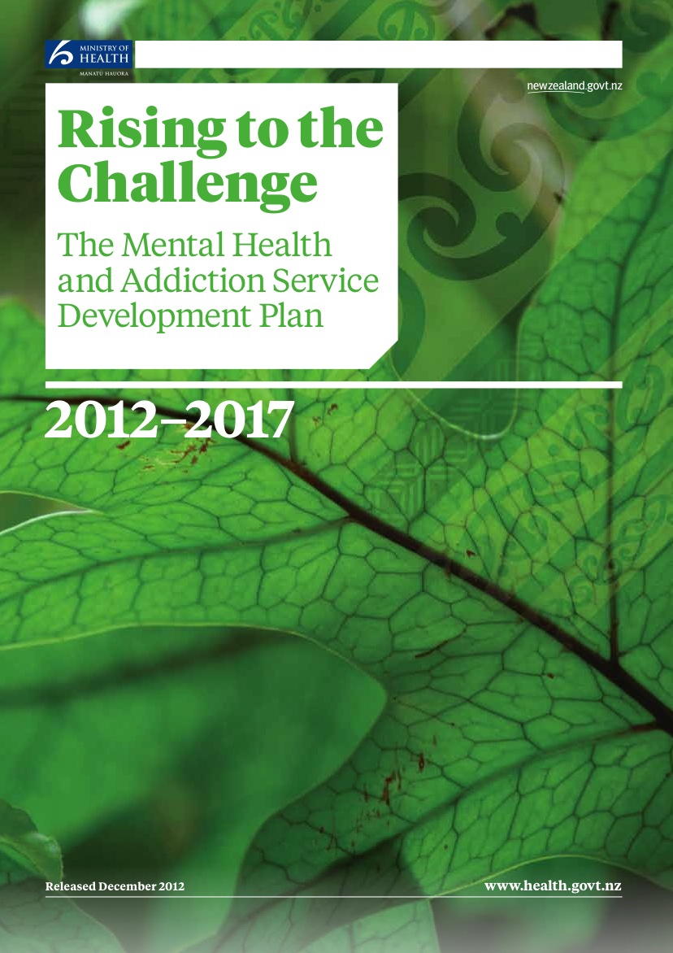
This document doesn’t include a single instance of the word “compassion”.
Notes:
See notes to previous slide.

