Slide 1
Our materialistic science is misleading – each of our patients is an amazingly dynamic mind-body whole being

Slide 2
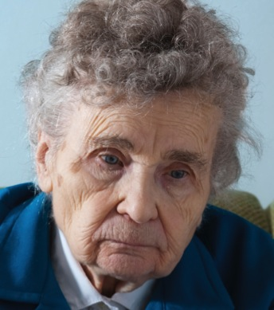
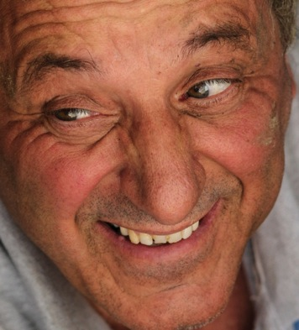
Pessimists
The profound influence of psychological wellbeing
Long-term survival after heart attack:
- pessimists have 4 times higher death rate from cardiac disease and 3 times higher mortality from all causes of death
Optimists
Notes:
1. Seligman MEP. Positive Health. Applied Psychology: An International Review. 2008;57:3-18.
This and other studies are extensively reviewed in Seligman’s article. Emotional and psychological factors have a profound impact on physical disease. In this study of survivors of heart attach, the level of optimism or pessimism of each patient was measured using a standardized questionnaire while they were doing cardiac rehab. Patient were then followed up for 12 to 15 years. Mortality rate was strikingly higher among those patients who were pessimists, independently of the severity of their cardiac condition or other risks factors.

Slide 3
Pessimists
The profound influence of psychological wellbeing
Chances of getting clinical influenza after standard inoculation:
- 3 times as many pessimists get influenza, as optimists
Optimists
Notes:
This study is also quoted in the Seligman review. Medical student volunteers were paid to be in a trial where a standardized dose of live influenza virus was applied to the nasopharynx. Prior to virus exposure, the students completed a questionnaire to measure levels of optimism and pessimism. The students were divided into three equal siz groups: pessimists, intermediate, optimists.
Most of the pessimists developed clinical influenza; few of the optimist did. The odds ratio was three to one.
Multiple studies have show that our thought and feelings profoundly affect the competence of our immune system. Patients who receive compassionate, kind and supportive care are less likely to get infections than those who are treated unkindly.

Slide 4
One episode of exercise changes gene expression.
3 hours of exercise per week for three months changed expression in 5,000 genes
Lindholm ME. Epigenetics. 2014 Dec;9(12):1557-69
Notes:
Lindholm ME, Marabita F, Gomez-Cabrero D, Rundqvist H, Ekstrom TJ, Tegner J, et al. An integrative analysis reveals coordinated reprogramming of the epigenome and the transcriptome in human skeletal muscle after training. Epigenetics. 2014;9(12):1557-69.
This study asked participants to cycle using only one leg, the other was rested. Gene expression was compared in muscle biopsies taken from both legs and confirmed that a one brief episode of exercise led to a change in gene expression. Regular exercise led to massive changes in gene expression.

Slide 5
Nine week mind-body program altered expression of 1,059 genes in a trial of patients with inflammatory bowel disease
Kuo B, et al. (2015) PLoS ONE 10(4): e0123861. doi:10.1371/journal. pone.0123861
Notes:
Kuo B, Bhasin M, Jacquart J, Scult MA, Slipp L, Riklin EI, et al. Genomic and clinical effects associated with a relaxation response mind-body intervention in patients with irritable bowel syndrome and inflammatory bowel disease. PLoS One. 2015;10(4):e0123861.
The nine-week mind-body program included such exercises as meditation, relaxation and cognitive restructuring of thoughts and beliefs about illness. It resulted in altered expression of more than a thousand genes concerned with cell reproduction, immune function and inflammatory responses. These gene expression changes were associated with reduction is condition-specific symptoms, anxiety levels and pain experience.

Slide 6
Emotional trauma affects our gene expression
In patients who responded to psychotherapy for Borderline Personality Disorder, improvement was associated with up-regulation of the gene for brain-derived neurotrophic factor (BDNF).
Our life experiences, beliefs and internal stories dynamically change our gene expression, altering health outcomes.
Notes:
1. Perroud N, Salzmann A, Prada P, Nicastro R, Hoeppli ME, Furrer S, et al. Response to psychotherapy in borderline personality disorder and methylation status of the BDNF gene. Transl Psychiatry. 2013;3:e207.
Downregulation of brain-derived neurotrophic factor (BDNF) gene expression with corresponding increased methylation at specific promoters has been associated with stressful experiences in early life and may explain later adulthood psychopathology. We measured the percentage of methylation at BDNF CpG exons I and IV as well as plasma BDNF protein levels in 115 subjects with borderline personality disorder (BPD) and 52 controls. BPD subjects then underwent a 4-week course of intensive dialectical behavior therapy (I-DBT).
Therapy responders showed a decrease in methylation status over time. Accordingly, the changes in methylation status over time were significantly associated with changes in depression scores, hopelessness scores and impulsivity.
Borderline Personality Disorder is associated with high levels of self harm and suicide. Fortunately, more than 80% of patients respond to Dialectal Behaviour Therapy, which is psychotherapy based on mindfulness, recognition of emotions, skills in emotional regulation and relationship. Some are permanently cured of the condition. What this study shows is that childhood emotional trauma causes down-regulation of the gene that makes an essential brain growth factor – the brain develops in a structurally abnormal way and the net result is an inability to regulate emotions. Therapy up-regulates the gene, turns on the brain growth factor and restructures the brain circuits, potentially curing the condition.

Slide 7
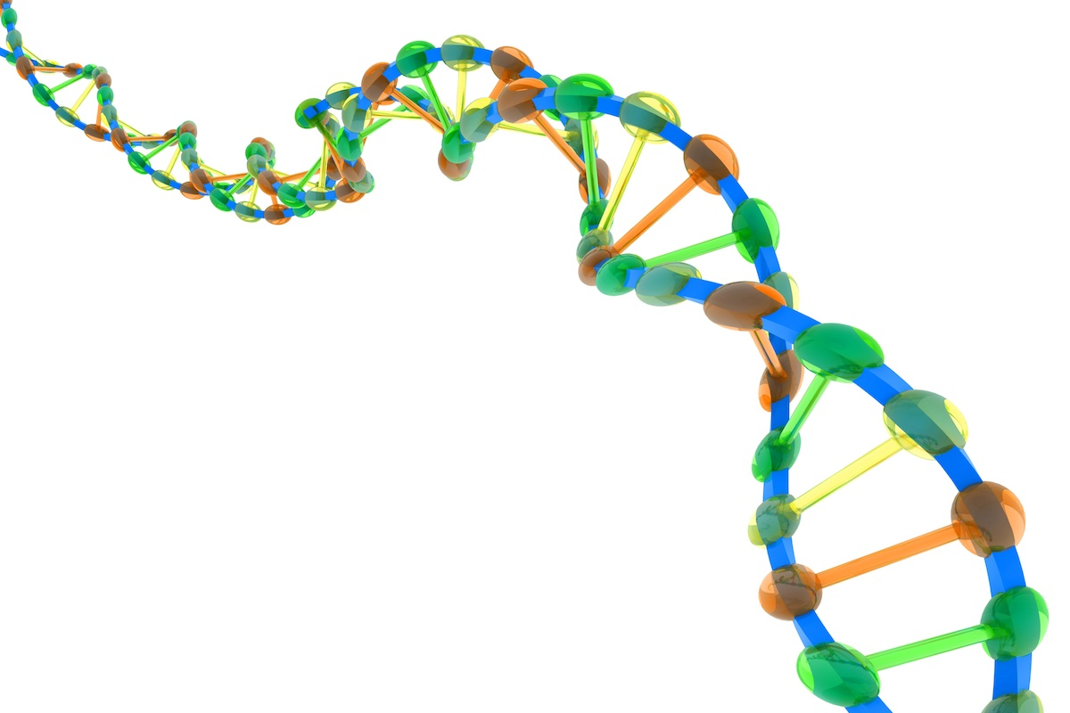
BRCA gene mutation and breast cancer
Angelina Jolie -prophylactic double mastectomy
Risk of breast cancer before age 70 with BRCA mutation?
2002 – 71.9%
1920 – only 18.6%
We are not helpless victims of our genes
Notes:
Tryggvadottir L, Sigvaldason H, Olafsdottir GH, Jonasson JG, Jonsson T, Tulinius H, et al. Population-based study of changing breast cancer risk in Icelandic BRCA2 mutation carriers, 1920-2000. J Natl Cancer Inst. 2006;98(2):116-22.
This study in Iceland traced the inheritance of the BRCA genes in families back to the 1920 and correlated it with the risk of developing breast cancer before age 70. Over that time, the penetrance of the BRCA gene increased 4-fold. What this shows is that emotional, psychological and environmental factors profoundly affect gene expression. The prevalent model of genetic determinism is profoundly misleading. Billions of dollars are being spent on research into the human genome and the sequencing of genes for individuals to “predict risk”. We would do much better to research the mind-body influences on gene expression and prevention of disease.

Slide 8
What does compassionate care look like?
Notes:
Here’s your opportunity to share your own wisdom.
We say that compassion is ‘caught’ rather than ‘taught’. People change their behavior when they see great role-models for compassionate care. Using your own experience and insights, tell some stories about compassionate care or the kinds of behaviors shown by deeply compassionate practitioners.
Here’s a recent Hearts in Healthcare article about healing consultations: http://heartsinhealthcare.com/ten-practical-steps-towards-healing-consultations/

Slide 9
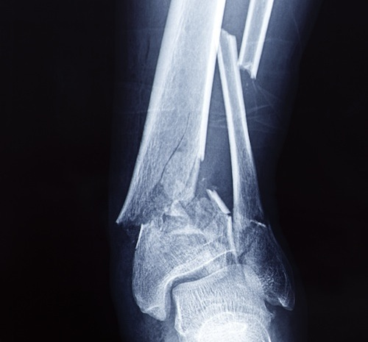
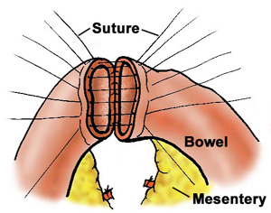
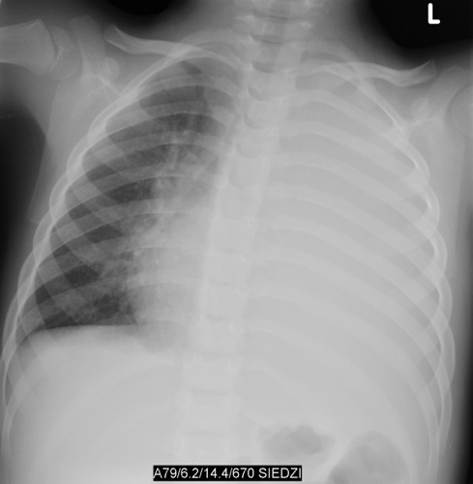
Doctors can ‘fix’ bones with screws and plates, connect bowel with sutures, and treat pneumonia with antibiotics. But the fusing of the bone, the joining of the bowel, and the disappearance of pus from a lung solid with pneumonia, are all miracles of healing.
Notes:
If we don’t treat a broken bone, it will still heal by itself – as happens in nature. The purpose of orthopedic treatment of fractures is to help the bone heal in proper alignment.
When a surgeon resects a segment of bowel to remove a cancer, the end of the bowel are stitched or stapled together. A week later, the bowel is perfectly joined. Try fixing a garden hose pipe by stitching the cut ends together – when you turn on the water it will spray everywhere! The garden hose doesn’t heal itself, living tissue does.
Another example is lobar pneumonia. The chest x-ray might show the lobe completely solid with pus. We treat with antibiotics to speed recovery but it’s the natural healing process that restores the lung to completely normal structure and function.

Slide 10
Spontaneous remission/regression
“SR of neoplasms occurs when the malignant tumor mass partially or completely disappears without any treatment or as a result of a therapy considered inadequate to influence systemic neoplastic disease.”
(Kaiser et al, In Vivo 2000 Nov-Dec; 14(6): 773-788)
3,500 documented case reports in 800 medical journals, in 20 languages
Notes:
Medical research focuses almost exclusively on pathology and disease, not on the conditions that allow people to naturally heal and recover. As a consequence, medical knowledge is profoundly unbalanced and most doctors are ignorant of the ability to patients to heal themselves, even in conditions such as terminal cancer. It’s deemed to be highly unprofessional to give patients “false hope” yet to completely destroy the hope of a patient is very wounding and uncompassionate.
This group have been systematically scanning the peer-reviewed medical literature for well-documented cases of spontaneous remission or regression of cancer and found 3,500 cases. Cases like this tend not to be reported in the medical literature because they are ‘embarrassing’ to medical experts because they are unexplainable in terms of conventional medical science. Spontaneous remission may be much more common.
The conventional medical view is that cancers must be detected early and removed, to save lives, because a small tumor will inevitably developing into an invasive cancer. This view is increasingly challenged: for instance research now shows that only 1 in 5 patient who have a ‘breast cancer’ found by mammography screening benefit from investigation and treatment. The other 4 out of 5 patients would never have come to harm from the small tumors because most of them spontaneously regress or remain dormant. Some countries are now abandoning national programs of breast screening because there is little or no evidence that the program affects mortality. On the other hand, huge numbers of patients are harmed by aggressive medical treatment of ‘tumours’ that will never cause harm. The difficulty is we can’t yet predict who will develop invasive cancer.
Furthermore, this research group has studied the characteristics of patients who survive against the expectations of their doctors. They are patients with optimism, a joy for life, supportive social networks, wholesome lifestyles, forms of stress relief, and a commitment to the care of others.

Slide 11
Happiness and gene expression… CTRA genes modulate the stress/threat response: pro-inflammatory, increased risk of arterial disease, cancer, neuro-degeneration and suppression of viral immunity
But there are TWO kinds of happiness:
Eudaimonic happiness - from the joy of serving others, compassion, caring.
Hedonic happiness - from serving your own material desires and pleasure
Hedonic happiness up-regulates CTRA genes – risk of chronic disease!
Eudaimonic happiness down-regulates CTRA genes – stay healthy!
Notes:
Fredrickson BL, Grewen KM, Coffey KA, Algoe SB, Firestine AM, Arevalo JM, et al. A functional genomic perspective on human well-being. Proc Natl Acad Sci U S A. 2013;110(33):13684-9.
CTRA is a cluster of 53 genes modulating the acute stress/threat response. Chronic activation is pro-inflammatory, a major risk factor for arterial and cardiac disease, cancer, and neuro-degerative disorders. Activation also suppresses the immune response to viral infection.

Slide 12
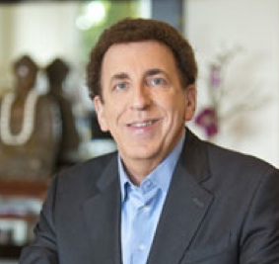
Dean Ornish, MD
Comprehensive lifestyle change can reverse coronary artery disease and halt the progression of prostate cancer (controlled trials)
How does Dr Ornish define lifestyle change?
Good diet Moderate exercise Social support Relaxation
Notes:
Ornish D, Scherwitz LW, Billings JH, Brown SE, Gould KL, Merritt TA, et al. Intensive lifestyle changes for reversal of coronary heart disease. Jama. 1998;280(23):2001-7.
Ornish D, Magbanua MJ, Weidner G, Weinberg V, Kemp C, Green C, et al. Changes in prostate gene expression in men undergoing an intensive nutrition and lifestyle intervention. Proceedings of the National Academy of Sciences of the United States of America. 2008;105(24):8369-74.
Ornish D, Weidner G, Fair WR, Marlin R, Pettengill EB, Raisin CJ, et al. Intensive lifestyle changes may affect the progression of prostate cancer. J Urol. 2005;174(3):1065-9; discussion 9-70.
Dean Ornish is the founder of the Preventive Medicine Research Institute and the world authority of impact of lifestyle change on disease progression.
The study of coronary disease showed reduction of coronary artery stenosis as shown on repeat coronary angiograms. The study on gene expression in patients showed that lifestyle intervention down-regulated 150 cancer-promoting genes and up-regulated 350 wellness related genes.

Slide 13
So how do we help our patients heal?
Through compassion - it’s our humane response to their suffering.
Notes:
What is the meaning of healing? – To transcend suffering.

Slide 14
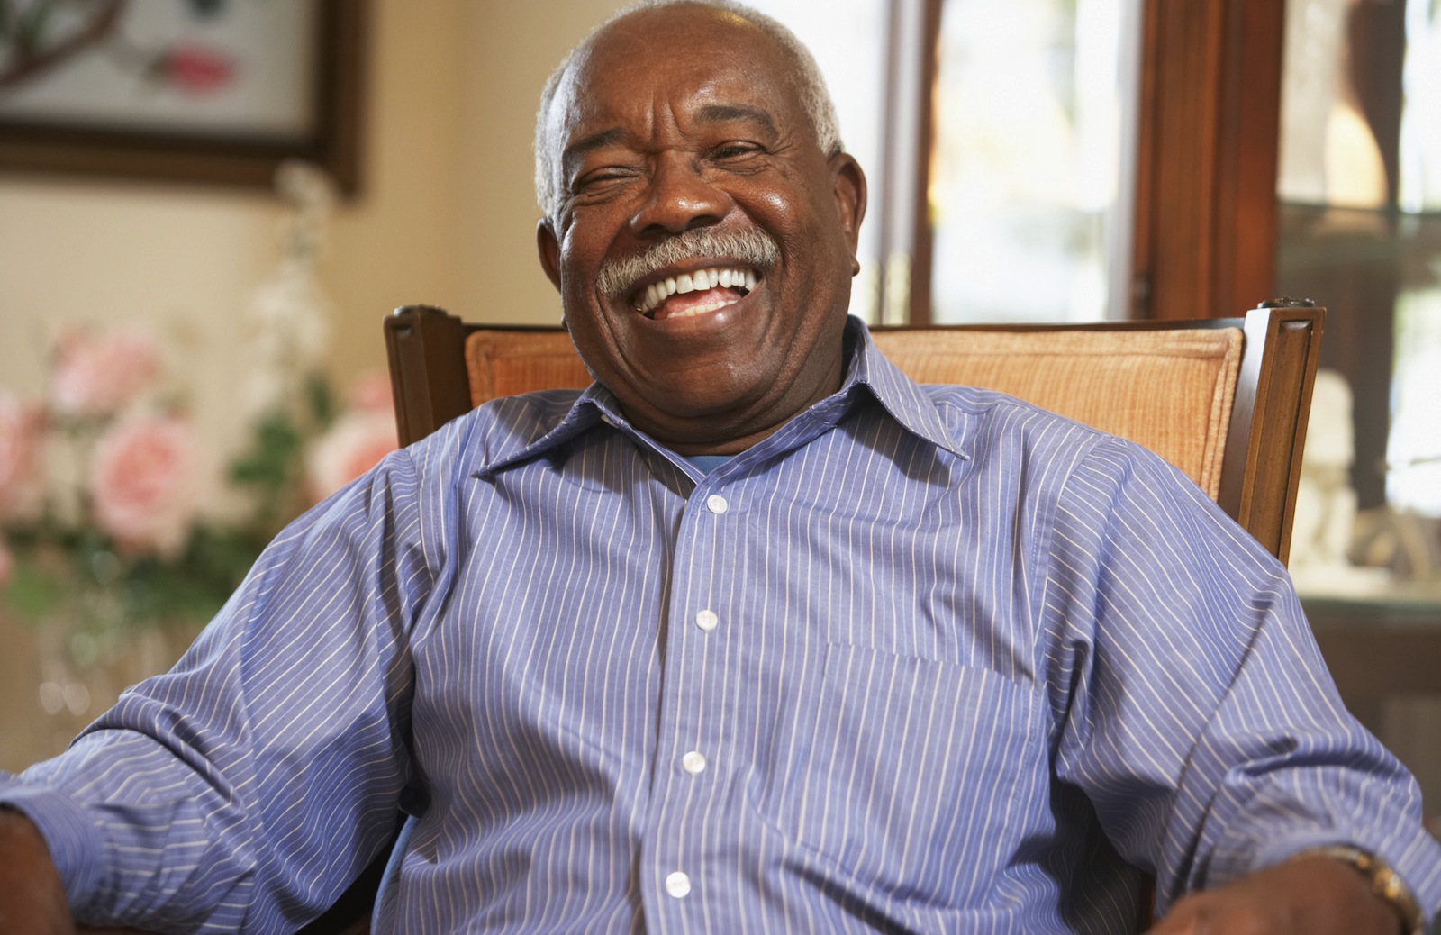
Our patients heal when they transcend suffering and find true happiness.
As health professionals we need to be the positive role models
Notes:
As health professionals we can’t expect our patients to find healing unless we ourselves attend first to our own healing. We need to be positive role models for health and wellbeing.

Slide 15
But there is only one person you can change…
Health professionals can’t change their patients, only themselves
- giving lifestyle advice to patients doesn’t work!
But health professionals who learn to find their own happiness and wellbeing, and practice with compassion, make an AMAZING difference to their patients
– we have to be the change we want to see in our patients.

Slide 16
OLD STORY…
Patient demand is overwhelming and uncontrollable
Patients are an abundant source of resilience, healing and wellbeing
NEW ASSUMPTIONS…
… NEW STORY
Notes:
See the next slides to illustrate this point.
When we become’ body mechanics’ just treating symptoms or fixing broken bits of our patients, then the demand for care is overwhelming – because we take responsibility for trying to make the patient better.
In reality, every patient has extraordinary capacity for self healing – this natural healing response is elicited when we care for compassion. Even patient with conditions like chronic back pain can be seen as extraordinarily resilient – ask patients how they manage to live day after day, in spite of chronic pain. What are the skills an strengths they draw upon to cope with the pain?

Slide 17
OLD STORY…
We are ‘body mechanics’ treating disease
We are healers treating whole people
NEW ASSUMPTIONS…
… NEW STORY
Notes:
From reductionist, materialistic medicine to caring for the whole person.

Slide 18
What is the meaning of healing?

Slide 19
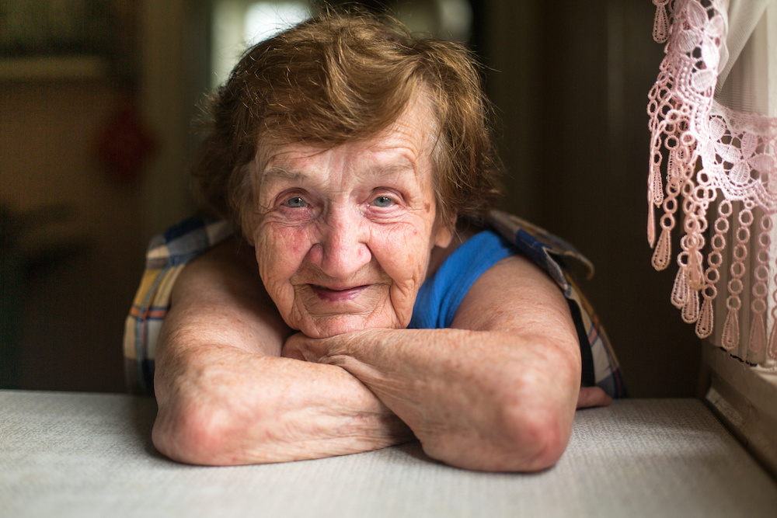
Transcending suffering

Slide 20
If you want others to be happy, practice compassion. If you want to be happy, practice compassion.
Ancient wisdom – the Golden Rule of Compassion
If you want others to be healthy, practice compassion. If you want to be healthy, practice compassion.

Slide 21
OLD STORY… (body mechanic)
Doctors set the agenda for investigation and treatment of disease…
Doctors bring their knowledge, skill and experience in service of the patient’s life
… NEW STORY (healer)
Notes:
This is the definition of truly patient-centered care, which dramatically improves outcomes and patient satisfaction, reduces interventions and costs, and gives meaning and joy to the work of health professionals

Slide 22
Understanding the story
Notes:
Beckman HB, Frankel RM. The effect of physician behavior on the collection of data. Ann Intern Med. 1984;101(5):692-6.
This classic study showed that in only 23% of the consultations was the patient provided the opportunity to complete his or her opening statement of concerns. The average time before the doctor interrupted was only 18 seconds.

Slide 23
The leading cause of health is happiness!

