Slide 1
Quotation here

Slide 2
The trouble with becoming an expert is that you sometimes try to find technical solutions to a human problem
Notes:
As health professionals, we invest many years of study in developing technical knowledge and skills. But if your only tool is a hammer, every problem looks like a nail.
To be truly compassionate practitioners we need to unlearn some of our professional teachings and expand our knowledge of compassionate caring and holistic mind-body-spirit medicine.

Slide 3
The hero’s journey
From battling to change the world out there to changing what lies in here
Notes:
This slide is an invitation to share a personal story and to be vulnerable.
Your greatest leadership power is not persuasion, it’s vulnerability. When you humbly admit mistakes, failures, or how you had to change yourself to be more effective – then you open the hearts and minds of your audience. You make it OK for others to question their attitudes and practice.

Slide 4
When I went back to the science, I found the right path…
Notes:
There is more to evidence than narrow, reductionist bio-medical research. As the slide collections on clinical outcomes and mind-body medicine show, compassionate care is based on really solid science and evidence.

Slide 5
Doctors believe in their treatments
Healers believe in their patients.
Notes:
Maybe you can tell a story to illustrate this point?

Slide 6
Compassion sometimes means sitting alongside people in their darkest places
Notes:
At Hearts in Healthcare we have done hundreds of workshop with health professionals asking them to share stories of deep connection to patients/clients. One of the archetypal stories that emerges, time after time, is the capacity for a health professional to sit alongside people in their deepest distress and darkest places, offering only compassion and silence.
The willingness of someone to sit with you and hold space in your darkest times is profoundly validating. Even when you believe you are utterly worthless and hateful, to experience the willingness of another to sit with you in love, compassion, and non-judgment is profoundly healing. We have heard many stories of life-transforming change in these circumstances, for instance of recovery from a deeply suicidal state or years of depression.
To act in this way requires great courage on the part of the health professional, to enter in to the world of pain with the patient or client, and to take professional risks by refusing to jump in with treatments or other rescue measures such as calling the police or ambulance.

Slide 7
Compassion means supporting the families
Notes:
Family members bear the brunt of caring for people with serious mental illness, whether it’s depression, self-harm, suicide attempts, mania or psychotic illness. In our experience, families are often given no support or education at all.
For instance, parents of suicidal teens or young adults may go through months or years of harrowing experience trying to support their loved ones and to keep them alive. There may be an overwhelming burden of anxiety, fear, shame, depression and emotional exhaustion.
Teaching family members simple techniques like ‘emotional validation’ can make a world of difference (see for instance, https://bpdfamily.com/content/communication-skills-dont-be-invalidating).
In addition, treating the mental illness as an individual ‘pathology’ without regard to social and family dynamics is absurd. Compassionate care of the person experiencing mental illness should always envelop the immediate family and carers in compassionate support and education.

Slide 8
You begin your career as a novice. But every health professional, from day one, has a fully formed heart. Let compassion be your great strength

Slide 9
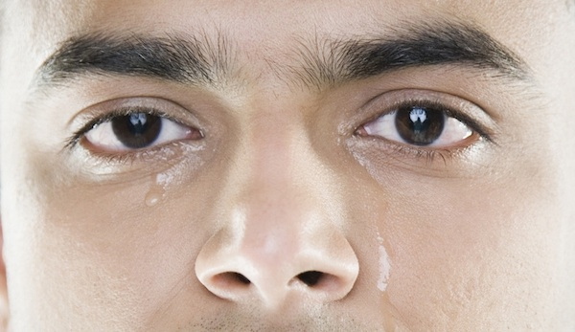
Doctors don’t cry
heartsinhealthcare.com/doctors-dont-cry/
Notes:
An article on the Hearts in Healthcare website: http://heartsinhealthcare.com/doctors-dont-cry/
If we are to have a fully compassionate healthcare system, we need to change models of professionalism. In this article I tell the story of a time when I shared tears with a patient. I think it is sometime appropriate to show emotions to patients or family members when faced with overwhelming loss or tragedy – it makes us human. When we develop the capacity for mindfulness and emotional regulation, we can remain professional and skillfully aware of our behavior and impact on others while still showing emotion. In these circumstances, I sometime ask patients if they would like a hug – often they do.

Slide 10
Fixing, helping and serving
Notes:
Remen RN. In the service of life. Noetic Sciences Review. 1996;37(Spring 1996):24.
Rachel Naomi Remen is a (retired) physician in the USA who was a pioneer in compassionate medicine and healing practice. She’s the author of the wonderful book, “Kitchen Table Wisdom”.
In this brief essay she talks about three different modes of relating to patients, fixing, helping and service. The distinction is hugely important.
“Fixing’ is the mode of practice I followed through most of my career as a medical specialist. I thought it was my job to diagnose problems and offer treatments – I wanted to ‘fix’ the patient using the knowledge, skill and expertise I had developed in many years of training. In this mode of relating, the patient is an entirely passive and helpless participant. The mode of ‘fixing’ sees the patient as a machine, not as a person.
‘Helping’ seems like a kinder and more compassionate mode of relating to a patient – we all want to help people in need. But every time we help a patient, we are judging them to be helpless to address their own problems. If we always rescue and help the patient, they will never develop the capacity to heal themselves. Once again, the clinician often sets the agenda.
Serving is an entirely different and humble way of relating to the patient, whom we believe has great powers of self-healing. It’s the patient who sets the agenda for care. After listening carefully to the patient and fully understanding their story, we humbly offer our knowledge, skills and power in service to the patient’s life and the patient’s concerns. This is the pathway to healing. We perceive the patient is the expert in themselves, we no longer need to be the expert and to have all the answers. When we truly serve our patients, we find great joy in our work.

